Slide 1

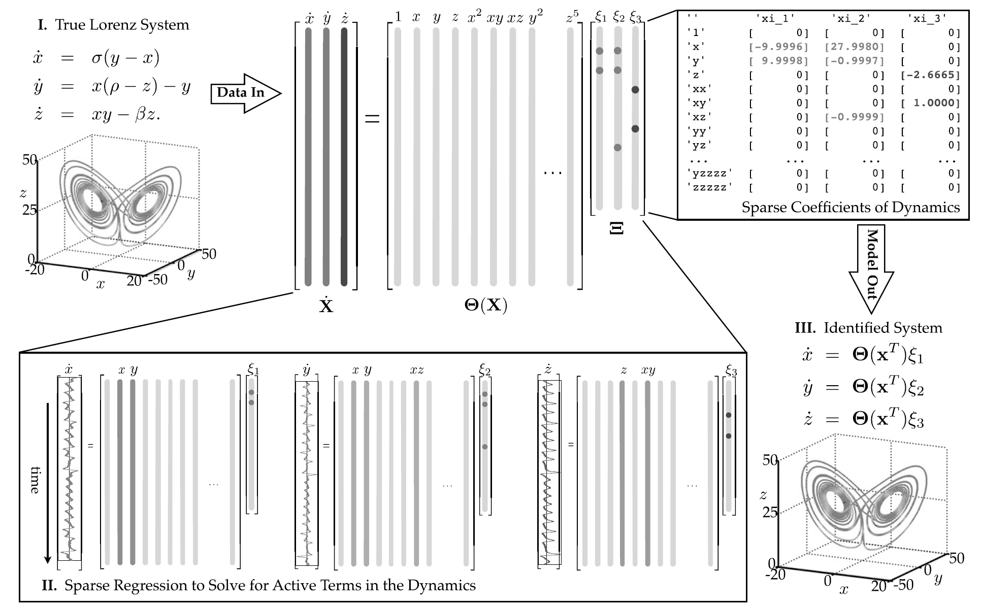
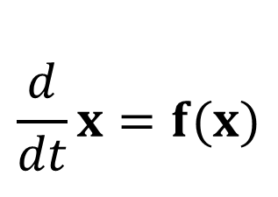
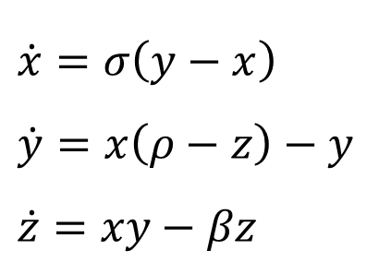
SINDy – Sparse Identification of Nonlinear Dynamics
Imperial I-X Symbolic Model Discovery Workshop 2025
Urban Fasel
SINDy
Data
Dynamics (assumptions)
Model structure & coefficients
$\dot{x}=σ\left(y−x\right)$
$\dot{y}=x\left(ρ−z\right)−y$
$\dot{z}=xy−βz$
$$\frac{d}{dt}x=f(x)$$
Notes:
Introduce SINDy idea
Content of lecture
My work / motivation -> next slide

Slide 2
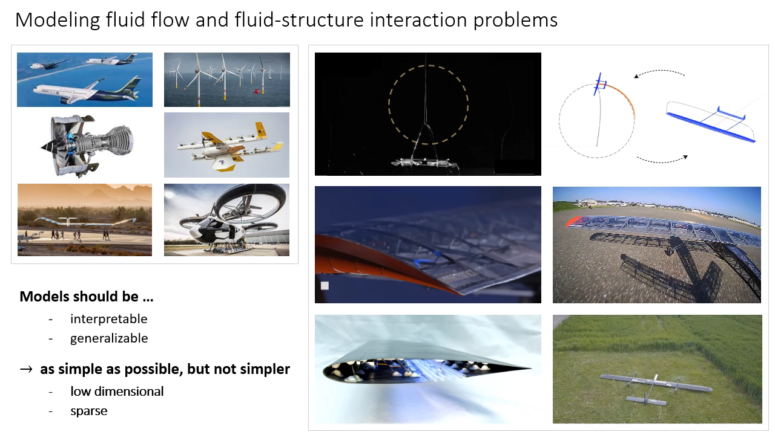
My work
(Adaptive) flight systems
Flapping wing MAV
Renewable energy systems
Composite additive manufacturing morphing wing drones
Morphing wings
Airborne wind energy
Methods
Co-design optimization
Data driven modeling & control
DMDc, SINDyC, SINDy-RL
E-SINDy, B-SINDy, SINDy-CP
Poincaré SINDy, Slow Manifolds
Notes:
My work
Key challenge: accurate and computationally efficient models
Interested in ML …
Ok so as I just mentioned I am broadly interested in modeling, design, and control of flight systems,
so on the right here, you can see a couple of problems that I am working on,
such as the AWE systems and flapping wing drones from the first slide,
and in the other videos on the bottom I show a couple of prototypes of morphing wing conceptual designs that I am also working on.

Slide 3
My work
(Adaptive) flight systems
Flapping wing MAV
Renewable energy systems
Composite additive manufacturing morphing wing drones
Morphing wings
Airborne wind energy
Methods
Co-design optimization
Data driven modeling & control
DMDc, SINDyC, SINDy-RL
E-SINDy, B-SINDy, SINDy-CP
Poincaré SINDy, Slow Manifolds
Notes:
My work
Key challenge: accurate and computationally efficient models
Interested in ML …
Ok so as I just mentioned I am broadly interested in modeling, design, and control of flight systems,
so on the right here, you can see a couple of problems that I am working on,
such as the AWE systems and flapping wing drones from the first slide,
and in the other videos on the bottom I show a couple of prototypes of morphing wing conceptual designs that I am also working on.

Slide 4
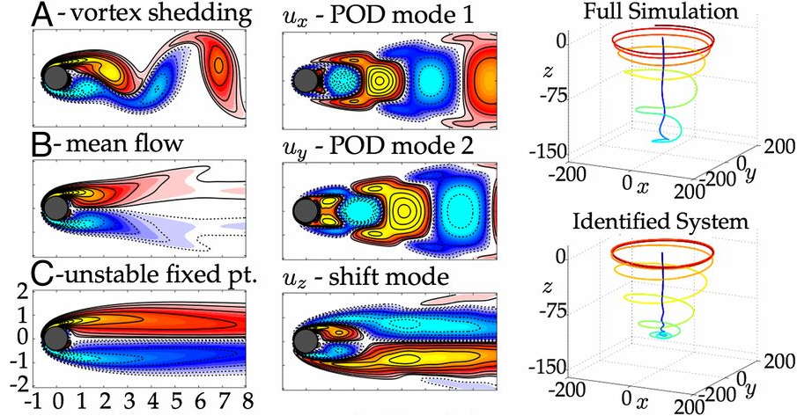
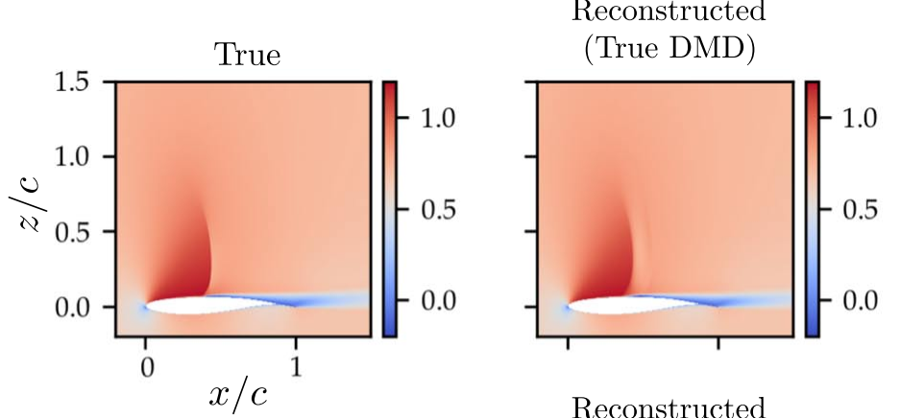
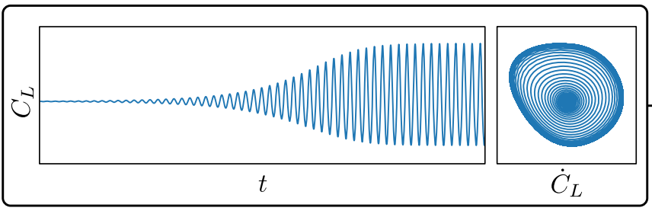
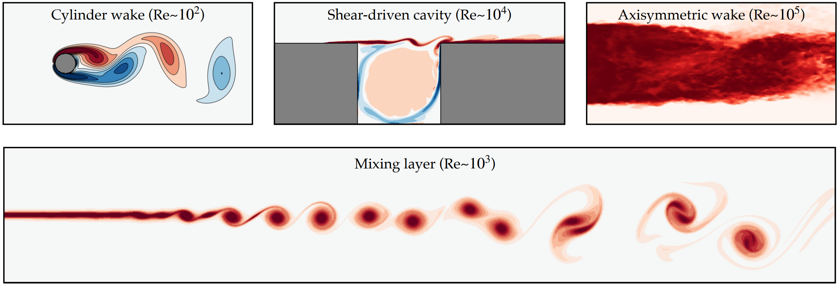
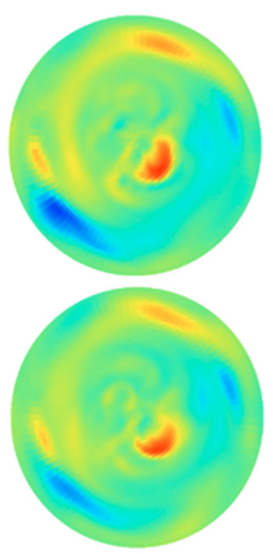
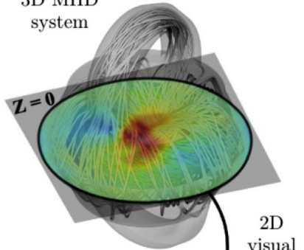
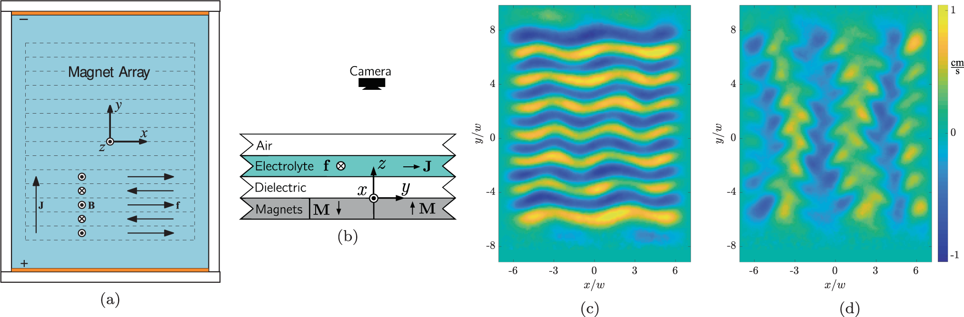
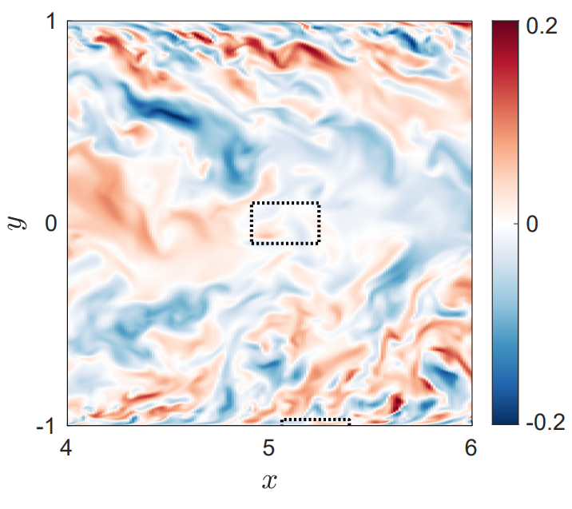
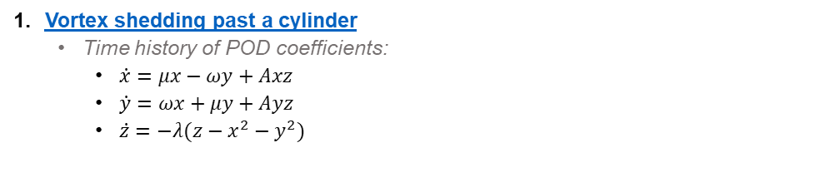
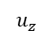
SINDy – applications
1
2
Reconstructed
True
Vortex shedding past a cylinder
Time history of POD coefficients:
$\dot{x}=μx−ωy+Axz$
$\dot{y}=ωx+μy+Ayz$
$\dot{z}=−λ(z−x^{2}−y^{2})$
3
5
True
4
Test
6
7
$$u_{z}$$
Notes:
SINDy paper 2016, before intro method, show applications, how sparse models look like
Shock wave oscillations
Jared: Stuart-Landau-type system of equations: pair of coupled oscillators
Spheromak: proposed as magnetic fusion energy concept
Jared: Quadratic terms are clearly necessary to capture the advective nonlinearity of the Navier–Stokes equations, but cubic terms allow the model to resolve Stuart–Landau-type nonlinear stability mechanisms
active degrees of freedom from correlated higher harmonics and nonlinear cross-talk
Spheromaks have been proposed as a magnetic fusion energy concept

Slide 5
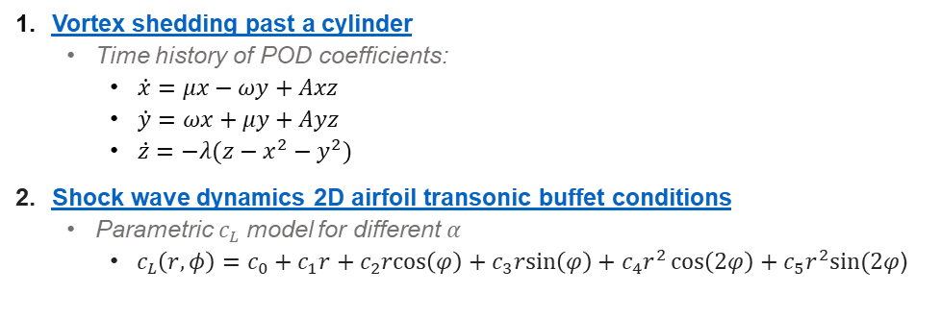
SINDy – applications
1
2
Reconstructed
True
Vortex shedding past a cylinder
Time history of POD coefficients:
$\dot{x}=μx−ωy+Axz$
$\dot{y}=ωx+μy+Ayz$
$\dot{z}=−λ(z−x^{2}−y^{2})$
Shock wave dynamics 2D airfoil transonic buffet conditions
Parametric $c_{L}$ model for different $α$
$c_{L}\left(r,φ\right)=c_{0}+c_{1}r+c_{2}rcos\left(φ\right)+c_{3}rsin\left(φ\right)+c_{4}r^{2}\cos\left(2φ\right)+c_{5}r^{2}sin⁡(2φ$)
3
5
True
4
Test
6
7
$$u_{z}$$
Notes:
SINDy paper 2016, before intro method, show applications, how sparse models look like
Shock wave oscillations
Jared: Stuart-Landau-type system of equations: pair of coupled oscillators
Spheromak: proposed as magnetic fusion energy concept
Jared: Quadratic terms are clearly necessary to capture the advective nonlinearity of the Navier–Stokes equations, but cubic terms allow the model to resolve Stuart–Landau-type nonlinear stability mechanisms
active degrees of freedom from correlated higher harmonics and nonlinear cross-talk
Spheromaks have been proposed as a magnetic fusion energy concept

Slide 6
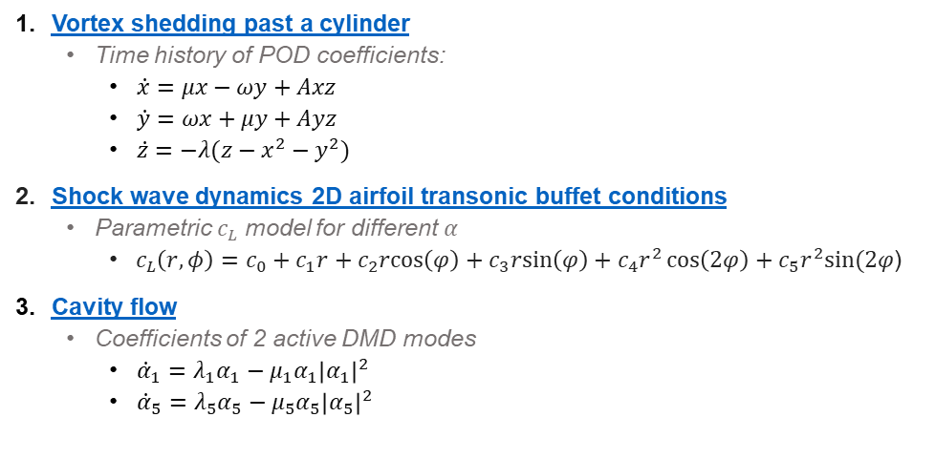
SINDy – applications
1
2
Reconstructed
True
Vortex shedding past a cylinder
Time history of POD coefficients:
$\dot{x}=μx−ωy+Axz$
$\dot{y}=ωx+μy+Ayz$
$\dot{z}=−λ(z−x^{2}−y^{2})$
Shock wave dynamics 2D airfoil transonic buffet conditions
Parametric $c_{L}$ model for different $α$
$c_{L}\left(r,φ\right)=c_{0}+c_{1}r+c_{2}rcos\left(φ\right)+c_{3}rsin\left(φ\right)+c_{4}r^{2}\cos\left(2φ\right)+c_{5}r^{2}sin⁡(2φ$)
Cavity flow
Coefficients of 2 active DMD modes
${\dot{α}}_{1}=λ_{1}α_{1}−μ_{1}α_{1}{\left|α_{1}\right|}^{2}$
${\dot{α}}_{5}=λ_{5}α_{5}−μ_{5}α_{5}{\left|α_{5}\right|}^{2}$
3
5
True
4
Test
6
7
$$u_{z}$$
Notes:
SINDy paper 2016, before intro method, show applications, how sparse models look like
Shock wave oscillations
Jared: Stuart-Landau-type system of equations: pair of coupled oscillators
Spheromak: proposed as magnetic fusion energy concept
Jared: Quadratic terms are clearly necessary to capture the advective nonlinearity of the Navier–Stokes equations, but cubic terms allow the model to resolve Stuart–Landau-type nonlinear stability mechanisms
active degrees of freedom from correlated higher harmonics and nonlinear cross-talk
Spheromaks have been proposed as a magnetic fusion energy concept

Slide 7
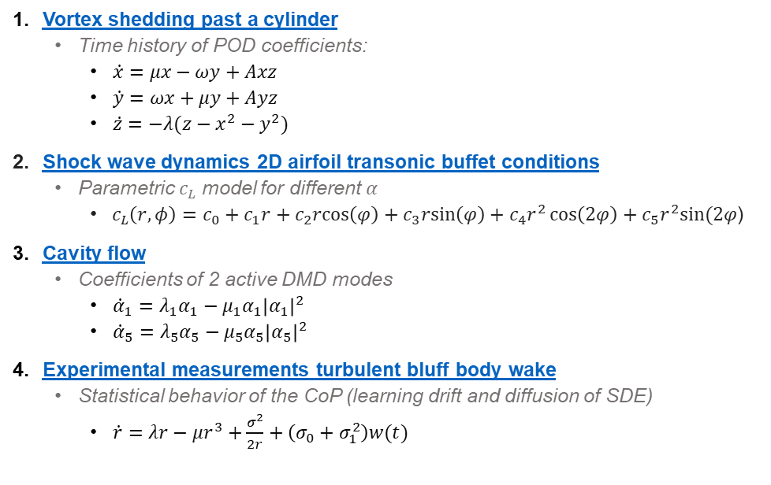
SINDy – applications
1
2
Reconstructed
True
Vortex shedding past a cylinder
Time history of POD coefficients:
$\dot{x}=μx−ωy+Axz$
$\dot{y}=ωx+μy+Ayz$
$\dot{z}=−λ(z−x^{2}−y^{2})$
Shock wave dynamics 2D airfoil transonic buffet conditions
Parametric $c_{L}$ model for different $α$
$c_{L}\left(r,φ\right)=c_{0}+c_{1}r+c_{2}rcos\left(φ\right)+c_{3}rsin\left(φ\right)+c_{4}r^{2}\cos\left(2φ\right)+c_{5}r^{2}sin⁡(2φ$)
Cavity flow
Coefficients of 2 active DMD modes
${\dot{α}}_{1}=λ_{1}α_{1}−μ_{1}α_{1}{\left|α_{1}\right|}^{2}$
${\dot{α}}_{5}=λ_{5}α_{5}−μ_{5}α_{5}{\left|α_{5}\right|}^{2}$
Experimental measurements turbulent bluff body wake
Statistical behavior of the CoP (learning drift and diffusion of SDE)
$\dot{r}=λr−μr^{3}+\frac{σ^{2}}{2r}+\left(σ_{0}+σ_{1}^{2}\right)w(t)$
3
5
True
4
Test
6
7
$$u_{z}$$
Notes:
SINDy paper 2016, before intro method, show applications, how sparse models look like
Shock wave oscillations
Jared: Stuart-Landau-type system of equations: pair of coupled oscillators
Spheromak: proposed as magnetic fusion energy concept
Jared: Quadratic terms are clearly necessary to capture the advective nonlinearity of the Navier–Stokes equations, but cubic terms allow the model to resolve Stuart–Landau-type nonlinear stability mechanisms
active degrees of freedom from correlated higher harmonics and nonlinear cross-talk
Spheromaks have been proposed as a magnetic fusion energy concept

Slide 8
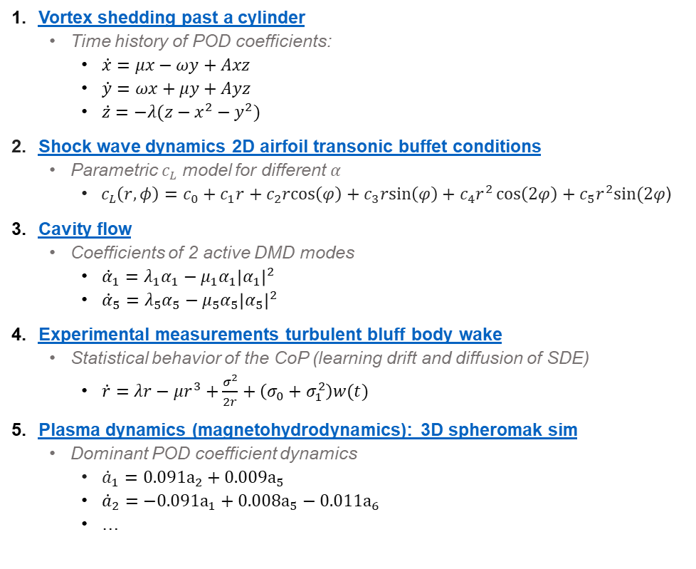
SINDy – applications
1
2
Reconstructed
True
Vortex shedding past a cylinder
Time history of POD coefficients:
$\dot{x}=μx−ωy+Axz$
$\dot{y}=ωx+μy+Ayz$
$\dot{z}=−λ(z−x^{2}−y^{2})$
Shock wave dynamics 2D airfoil transonic buffet conditions
Parametric $c_{L}$ model for different $α$
$c_{L}\left(r,φ\right)=c_{0}+c_{1}r+c_{2}rcos\left(φ\right)+c_{3}rsin\left(φ\right)+c_{4}r^{2}\cos\left(2φ\right)+c_{5}r^{2}sin⁡(2φ$)
Cavity flow
Coefficients of 2 active DMD modes
${\dot{α}}_{1}=λ_{1}α_{1}−μ_{1}α_{1}{\left|α_{1}\right|}^{2}$
${\dot{α}}_{5}=λ_{5}α_{5}−μ_{5}α_{5}{\left|α_{5}\right|}^{2}$
Experimental measurements turbulent bluff body wake
Statistical behavior of the CoP (learning drift and diffusion of SDE)
$\dot{r}=λr−μr^{3}+\frac{σ^{2}}{2r}+\left(σ_{0}+σ_{1}^{2}\right)w(t)$
Plasma dynamics (magnetohydrodynamics): 3D spheromak sim
Dominant POD coefficient dynamics
${\dot{a}}_{1}=0.091a_{2}+0.009a_{5}$
${\dot{a}}_{2}=−0.091a_{1}+0.008a_{5}−0.011a_{6}$
…
3
5
True
4
Test
6
7
$$u_{z}$$
Notes:
SINDy paper 2016, before intro method, show applications, how sparse models look like
Shock wave oscillations
Jared: Stuart-Landau-type system of equations: pair of coupled oscillators
Spheromak: proposed as magnetic fusion energy concept
Jared: Quadratic terms are clearly necessary to capture the advective nonlinearity of the Navier–Stokes equations, but cubic terms allow the model to resolve Stuart–Landau-type nonlinear stability mechanisms
active degrees of freedom from correlated higher harmonics and nonlinear cross-talk
Spheromaks have been proposed as a magnetic fusion energy concept

Slide 9
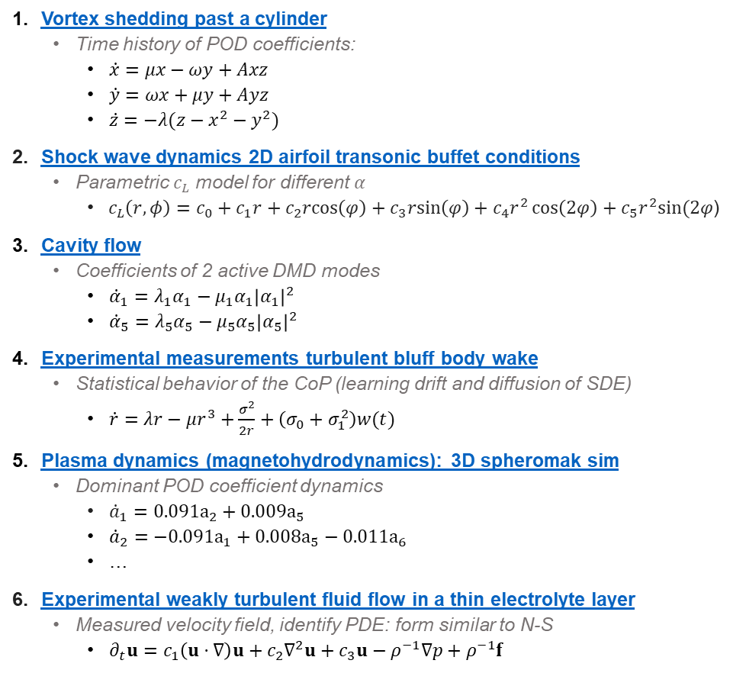
SINDy – applications
1
2
Reconstructed
True
Vortex shedding past a cylinder
Time history of POD coefficients:
$\dot{x}=μx−ωy+Axz$
$\dot{y}=ωx+μy+Ayz$
$\dot{z}=−λ(z−x^{2}−y^{2})$
Shock wave dynamics 2D airfoil transonic buffet conditions
Parametric $c_{L}$ model for different $α$
$c_{L}\left(r,φ\right)=c_{0}+c_{1}r+c_{2}rcos\left(φ\right)+c_{3}rsin\left(φ\right)+c_{4}r^{2}\cos\left(2φ\right)+c_{5}r^{2}sin⁡(2φ$)
Cavity flow
Coefficients of 2 active DMD modes
${\dot{α}}_{1}=λ_{1}α_{1}−μ_{1}α_{1}{\left|α_{1}\right|}^{2}$
${\dot{α}}_{5}=λ_{5}α_{5}−μ_{5}α_{5}{\left|α_{5}\right|}^{2}$
Experimental measurements turbulent bluff body wake
Statistical behavior of the CoP (learning drift and diffusion of SDE)
$\dot{r}=λr−μr^{3}+\frac{σ^{2}}{2r}+\left(σ_{0}+σ_{1}^{2}\right)w(t)$
Plasma dynamics (magnetohydrodynamics): 3D spheromak sim
Dominant POD coefficient dynamics
${\dot{a}}_{1}=0.091a_{2}+0.009a_{5}$
${\dot{a}}_{2}=−0.091a_{1}+0.008a_{5}−0.011a_{6}$
…
Experimental weakly turbulent fluid flow in a thin electrolyte layer
Measured velocity field, identify PDE: form similar to N-S
$∂_{t}u=c_{1}\left(u⋅∇\right)u+c_{2}∇^{2}u+c_{3}u−ρ^{−1}∇p+ρ^{−1}f$
3
5
True
4
Test
6
7
$$u_{z}$$
Notes:
SINDy paper 2016, before intro method, show applications, how sparse models look like
Shock wave oscillations
Jared: Stuart-Landau-type system of equations: pair of coupled oscillators
Spheromak: proposed as magnetic fusion energy concept
Jared: Quadratic terms are clearly necessary to capture the advective nonlinearity of the Navier–Stokes equations, but cubic terms allow the model to resolve Stuart–Landau-type nonlinear stability mechanisms
active degrees of freedom from correlated higher harmonics and nonlinear cross-talk
Spheromaks have been proposed as a magnetic fusion energy concept

Slide 10
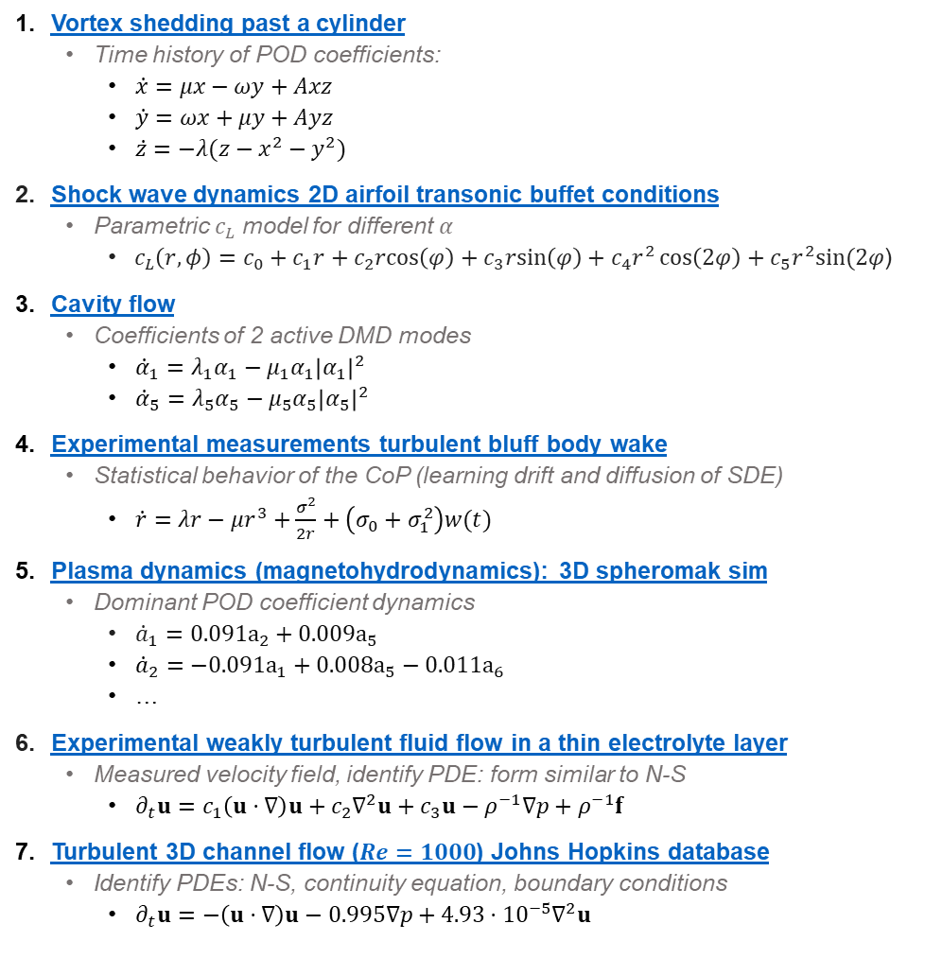
SINDy – applications
1
2
Reconstructed
True
Vortex shedding past a cylinder
Time history of POD coefficients:
$\dot{x}=μx−ωy+Axz$
$\dot{y}=ωx+μy+Ayz$
$\dot{z}=−λ(z−x^{2}−y^{2})$
Shock wave dynamics 2D airfoil transonic buffet conditions
Parametric $c_{L}$ model for different $α$
$c_{L}\left(r,φ\right)=c_{0}+c_{1}r+c_{2}rcos\left(φ\right)+c_{3}rsin\left(φ\right)+c_{4}r^{2}\cos\left(2φ\right)+c_{5}r^{2}sin⁡(2φ$)
Cavity flow
Coefficients of 2 active DMD modes
${\dot{α}}_{1}=λ_{1}α_{1}−μ_{1}α_{1}{\left|α_{1}\right|}^{2}$
${\dot{α}}_{5}=λ_{5}α_{5}−μ_{5}α_{5}{\left|α_{5}\right|}^{2}$
Experimental measurements turbulent bluff body wake
Statistical behavior of the CoP (learning drift and diffusion of SDE)
$\dot{r}=λr−μr^{3}+\frac{σ^{2}}{2r}+\left(σ_{0}+σ_{1}^{2}\right)w(t)$
Plasma dynamics (magnetohydrodynamics): 3D spheromak sim
Dominant POD coefficient dynamics
${\dot{a}}_{1}=0.091a_{2}+0.009a_{5}$
${\dot{a}}_{2}=−0.091a_{1}+0.008a_{5}−0.011a_{6}$
…
Experimental weakly turbulent fluid flow in a thin electrolyte layer
Measured velocity field, identify PDE: form similar to N-S
$∂_{t}u=c_{1}\left(u⋅∇\right)u+c_{2}∇^{2}u+c_{3}u−ρ^{−1}∇p+ρ^{−1}f$
Turbulent 3D channel flow ($Re=1000$) Johns Hopkins database
Identify PDEs: N-S, continuity equation, boundary conditions
$∂_{t}u=−\left(u⋅∇\right)u−0.995∇p+4.93⋅{10}^{−5}∇^{2}u$
3
5
True
4
Test
6
7
$$u_{z}$$
Notes:
SINDy paper 2016, before intro method, show applications, how sparse models look like
Shock wave oscillations
Jared: Stuart-Landau-type system of equations: pair of coupled oscillators
Spheromak: proposed as magnetic fusion energy concept
Jared: Quadratic terms are clearly necessary to capture the advective nonlinearity of the Navier–Stokes equations, but cubic terms allow the model to resolve Stuart–Landau-type nonlinear stability mechanisms
active degrees of freedom from correlated higher harmonics and nonlinear cross-talk
Spheromaks have been proposed as a magnetic fusion energy concept

Slide 11
Workshop outline
Part 1: SINDy – Sparse Identification of Nonlinear Dynamics
Intro: identifying ODEs
Python example: Lorenz system
SINDy challenges and limitations
Part 2: Library (ODEs, PDEs, rational functions)
Part 3: Model selection
Part 4: Noise robustness: weak form & ensemble SINDy
Part 5: PySINDy
“Vanilla” SINDy
SINDy extensions & applications
Notes:
Morning lectures, afternoon tutorials: MATLAB, PySINDy
Discuss limitations, comparison with other methods introduced: NN, Bayesian inference

Slide 12
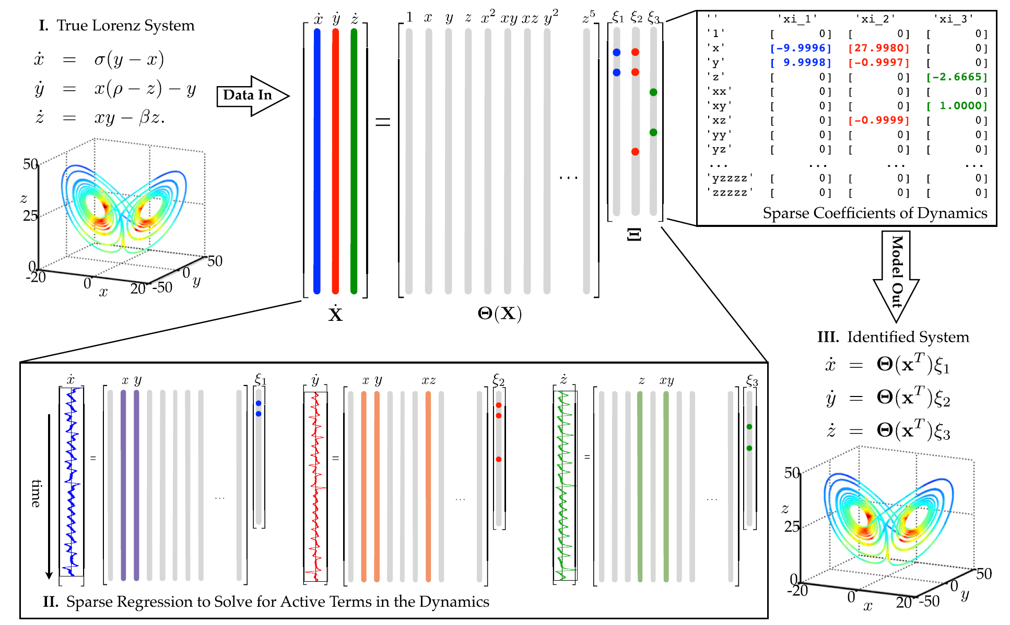
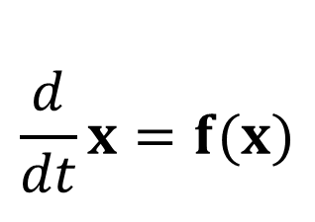
Identifying ODEs and PDEs from data – SINDy
Data
Dynamics (assumptions)
$$\frac{d}{dt}x=f(x)$$
SL Brunton, JL Proctor, JN Kutz (2016) Discovering governing equations from data by sparse identification of nonlinear dynamical systems.
Notes:
Mentioned at the beginning
Ok now before talking about these different applications that I am working on, let me introduce the SINDy algorithm first.
So the method was published in 2016 by Steve Brunton, Josh Proctor and Nathan Kutz,
And the goal of the method is as I mentioned before to learn interpretable and generalizable models from data
So it’s basically a machine learning method that can extract dynamical system models from time series data,
And, if we have a pure time series, for instance x,y,z data over time from the Lorenz system, so the butterfly attractor shown here on the left, …
the dynamical system that we would learn would be of the form of an ordinary differential equation,

Slide 13
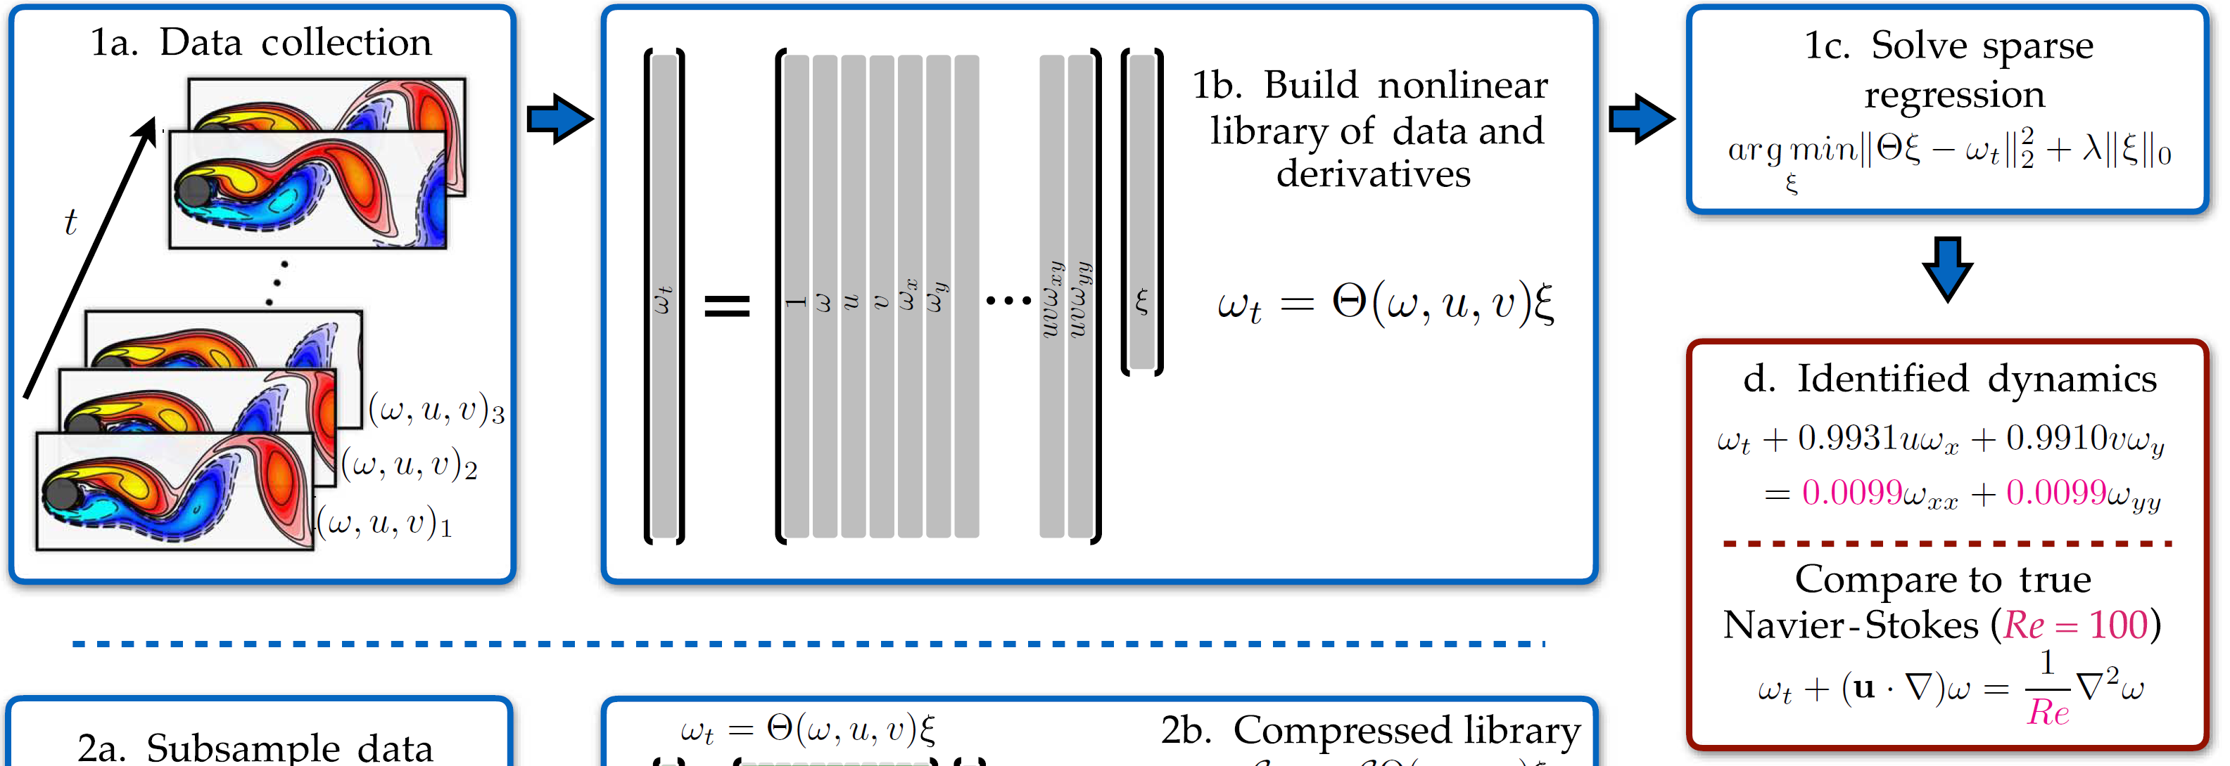
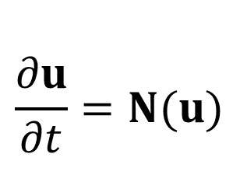
Identifying ODEs and PDEs from data – SINDy
Data
Dynamics (assumptions)
$$\frac{d}{dt}x=f(x)$$
$$\frac{∂u}{∂t}=N(u)$$
SL Brunton, JL Proctor, JN Kutz (2016) Discovering governing equations from data by sparse identification of nonlinear dynamical systems.
Notes:
PDEs…
Or if we would have spatio temporal data, …
for instance snapshots of the velocity and vorticity fields over time of the flow past a cylinder,
shown here on the bottom left,
the dynamical system model we would want to learn would be of the form of a partial differential equation

Slide 14
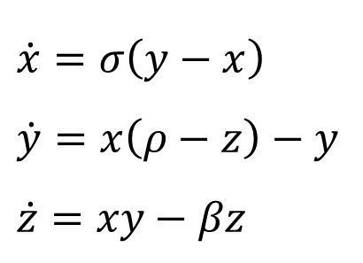
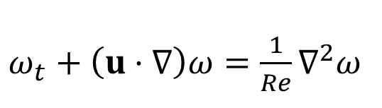
Identifying ODEs and PDEs from data – SINDy
Data
Dynamics (assumptions)
Model structure
& coefficients
$$\frac{d}{dt}x=f(x)$$
$\dot{x}=σ\left(y−x\right)$
$\dot{y}=x\left(ρ−z\right)−y$
$\dot{z}=xy−βz$
$$\frac{∂u}{∂t}=N(u)$$
$ω_{t}+\left(u⋅∇\right)ω=\frac{1}{Re}∇^{2}ω$
SL Brunton, JL Proctor, JN Kutz (2016) Discovering governing equations from data by sparse identification of nonlinear dynamical systems.
Notes:
And what SINDy does is that it can identify sparse differential equations that best describe the data,
so we can for example learn the exact ODE of the Lorenz system dynamics,
or for the flow past a cylinder, we can learn a PDE like the Navier Stokes equations …
with the sparsest or smallest number of active terms in the differential equations that still accurately fits the data.
So the main idea is that we don’t just want a model that best fits the data, …
like a large neural network that could potentially fit our data very accurately, and which could also be used for accurate forecasting, …
but we want to learn a sparse or compact equation that best describes the dynamics, which we can understand and interpret.
So this is basically what the SINDy algorithm does.
Ok, now, to introduce the algorithm in detail, I will use the Lorenz system dynamics data, …
so I will introduce how we can identify ODEs from data, …
but the method can also be extended and applied to spatio temporal data sets to identify PDEs.

Slide 15
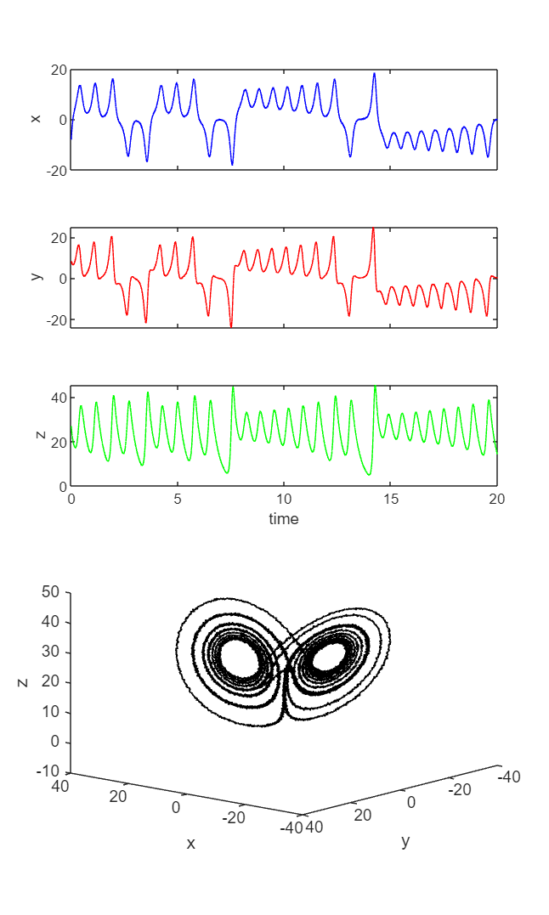
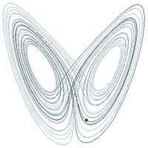
SINDy
1) True Lorenz System
Collect time series data ($ρ$ = 28, $σ$ = 10, $β$ = 8/3)
time
x
Time series
y
z
time
Phase space (attractor)
SL Brunton, JL Proctor, JN Kutz (2016) Discovering governing equations from data by sparse identification of nonlinear dynamical systems.
Notes:
SINDy
Ok, so how does the method work.
So for this syntenic Lorenz system data set, we would pretend that we have only access to measurement data, …
but we don’t know what the underlying dynamics are,
so here, we would measure a time series of the x,y,z states, but we wouldn’t have access to the ODE that generates the data.
Now shown here on this slide, the right three columns are the time series
And then, we would assume that we can calculate the time derivatives of the states, so the 3 columns on the left are xdot,ydot,zdot
And this is quite a strong assumption that we can compute these derivatives,
so it is no problem to get these derivatives for our synthetic Lorenz system data, …
but when we think about noisy experimental data, this can be very challenging.
but there are methods that can deal with this that I will introduce in a minute.

Slide 16
SINDy
1) Lorenz System Data
time
time
SL Brunton, JL Proctor, JN Kutz (2016) Discovering governing equations from data by sparse identification of nonlinear dynamical systems.
Notes:
SINDy
Ok, so how does the method work.
So for this syntenic Lorenz system data set, we would pretend that we have only access to measurement data, …
but we don’t know what the underlying dynamics are,
so here, we would measure a time series of the x,y,z states, but we wouldn’t have access to the ODE that generates the data.
Now shown here on this slide, the right three columns are the time series
And then, we would assume that we can calculate the time derivatives of the states, so the 3 columns on the left are xdot,ydot,zdot
And this is quite a strong assumption that we can compute these derivatives,
so it is no problem to get these derivatives for our synthetic Lorenz system data, …
but when we think about noisy experimental data, this can be very challenging.
but there are methods that can deal with this that I will introduce in a minute.

Slide 17
SINDy
1) Lorenz System Data
time
time
SL Brunton, JL Proctor, JN Kutz (2016) Discovering governing equations from data by sparse identification of nonlinear dynamical systems.
Notes:
SINDy
Ok, so how does the method work.
So for this syntenic Lorenz system data set, we would pretend that we have only access to measurement data, …
but we don’t know what the underlying dynamics are,
so here, we would measure a time series of the x,y,z states, but we wouldn’t have access to the ODE that generates the data.
Now shown here on this slide, the right three columns are the time series
And then, we would assume that we can calculate the time derivatives of the states, so the 3 columns on the left are xdot,ydot,zdot
And this is quite a strong assumption that we can compute these derivatives,
so it is no problem to get these derivatives for our synthetic Lorenz system data, …
but when we think about noisy experimental data, this can be very challenging.
but there are methods that can deal with this that I will introduce in a minute.

Slide 18
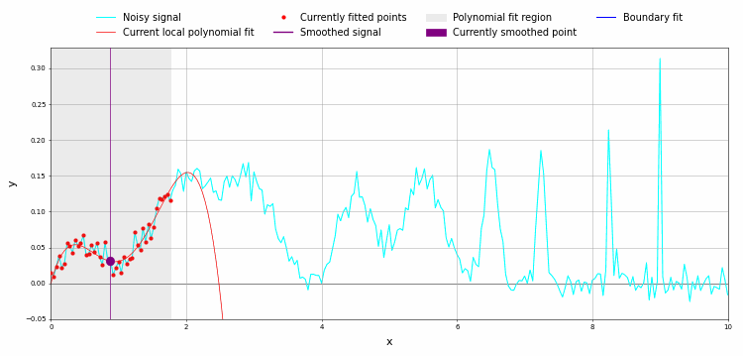
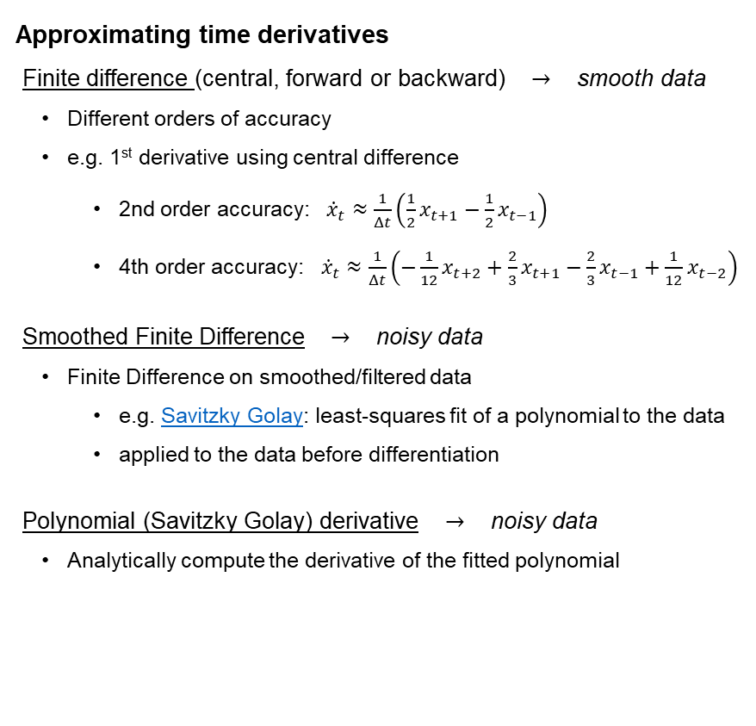
Approximating time derivatives
Finite difference (central, forward or backward) $→$ smooth data
Different orders of accuracy
e.g. 1st derivative using central difference
2nd order accuracy: ${\dot{x}}_{t}≈\frac{1}{Δt}\left(\frac{1}{2}x_{t+1}−\frac{1}{2}x_{t−1}\right)$​
4th order accuracy: ${\dot{x}}_{t}≈\frac{1}{Δt}\left(−\frac{1}{12}x_{t+2}+\frac{2}{3}x_{t+1}−\frac{2}{3}x_{t−1}+\frac{1}{12}x_{t−2}\right)$
Smoothed Finite Difference $→$ noisy data
Finite Difference on smoothed/filtered data
e.g. Savitzky Golay: least-squares fit of a polynomial to the data
applied to the data before differentiation
Polynomial (Savitzky Golay) derivative $→$ noisy data
Analytically compute the derivative of the fitted polynomial
SINDy
1) Lorenz System Data
time
time
SL Brunton, JL Proctor, JN Kutz (2016) Discovering governing equations from data by sparse identification of nonlinear dynamical systems.
Notes:
SINDy
Ok, so how does the method work.
So for this syntenic Lorenz system data set, we would pretend that we have only access to measurement data, …
but we don’t know what the underlying dynamics are,
so here, we would measure a time series of the x,y,z states, but we wouldn’t have access to the ODE that generates the data.
Now shown here on this slide, the right three columns are the time series
And then, we would assume that we can calculate the time derivatives of the states, so the 3 columns on the left are xdot,ydot,zdot
And this is quite a strong assumption that we can compute these derivatives,
so it is no problem to get these derivatives for our synthetic Lorenz system data, …
but when we think about noisy experimental data, this can be very challenging.
but there are methods that can deal with this that I will introduce in a minute.

Slide 19
SINDy
1) Lorenz System Data
time
SL Brunton, JL Proctor, JN Kutz (2016) Discovering governing equations from data by sparse identification of nonlinear dynamical systems.
Notes:
Library
So instead, what SINDy does, is to not only consider a linear model but it augments the right hand side of the equation to include nonlinear terms
So it builds a large library of candidate nonlinear terms that could potentially describe the measurement data.
So for example we can use a library of polynomials, in this example that I show here, for example polynomials up to fifth order.
And all the grey columns, so the additional terms in our library, we can directly calculate from our measured state.
So we augment the right hand side and build a library with nonlinear terms that could be used to describe the time derivatives on our left hand side

Slide 20
SINDy
1) Lorenz System Data
time
2) Sparse Regression to Solve for Active Terms in the Dynamics
SL Brunton, JL Proctor, JN Kutz (2016) Discovering governing equations from data by sparse identification of nonlinear dynamical systems.
Notes:
Find fewest active terms
Now the goal of SINDy is to find the fewest active terms in the library that best describe the dynamics
So we want to find an equation that best describes the 3 equations, for xdot, ydot, and zdot.
So I want to find the fewest columns of my library, that add up to xdot, ydot, and zdot

Slide 21
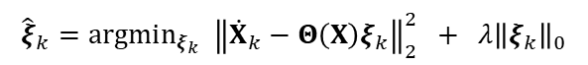
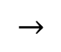
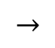
SINDy
1) Lorenz System Data
Sparse regression: penalised least squares
$$→$$
$${\hat{ξ}}_{k}=argmin_{ξ_{k}} {\left\|{\dot{X}}_{k}−Θ\left(X\right)ξ_{k}\right\|}_{2}^{2} + λ{\left\|ξ_{k}\right\|}_{0}$$
$$→$$
sequential thresholded least squares algorithm
time
2) Sparse Regression to Solve for Active Terms in the Dynamics
SL Brunton, JL Proctor, JN Kutz (2016) Discovering governing equations from data by sparse identification of nonlinear dynamical systems.
Notes:
Sparse regression
And the way we do this is by a sparse regression.
And there are a lot of different optimization algorithms that can efficiently solve this sparse regression problem,
but we mostly use a sequentially thresholded least squares algorithm.
So we sequentially solve a least squares problem and thresholds coefficients from our least squares solution
that are smaller than a sparsification parameter …
that basically defines the trade-off between accuracy and complexity of the discovered model,
and we repeat this until we get a final, sparse SINDy model.
So we solve a least squares problem, threshold small coefficients, …
and perform the least squares again and again on the smaller library, until we find a sparse SINDy model.

Slide 22
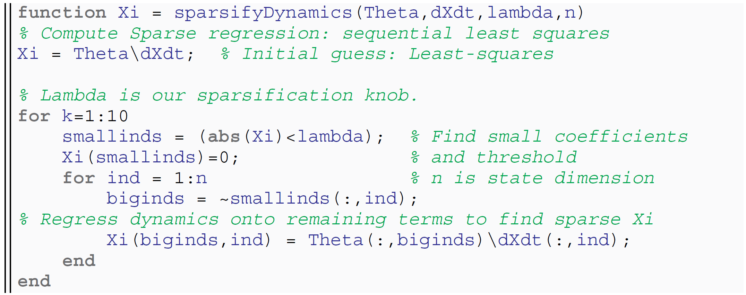
Sequential thresholded least squares algorithm
Sparse regression: penalised least squares
$$→$$
$${\hat{ξ}}_{k}=argmin_{ξ_{k}} {\left\|{\dot{X}}_{k}−Θ\left(X\right)ξ_{k}\right\|}_{2}^{2} + λ{\left\|ξ_{k}\right\|}_{0}$$
$$→$$
time
SL Brunton, JL Proctor, JN Kutz (2016) Discovering governing equations from data by sparse identification of nonlinear dynamical systems.
Notes:
Sparse regression
And the way we do this is by a sparse regression.
And there are a lot of different optimization algorithms that can efficiently solve this sparse regression problem,
but we mostly use a sequentially thresholded least squares algorithm.
So we sequentially solve a least squares problem and thresholds coefficients from our least squares solution
that are smaller than a sparsification parameter …
that basically defines the trade-off between accuracy and complexity of the discovered model,
and we repeat this until we get a final, sparse SINDy model.
So we solve a least squares problem, threshold small coefficients, …
and perform the least squares again and again on the smaller library, until we find a sparse SINDy model.

Slide 23
SINDy
1) Lorenz System Data
time
3) Sparse Coefficients of Dynamics
4) Identified SINDy model prediction
2) Sparse Regression to Solve for Active Terms in the Dynamics
SL Brunton, JL Proctor, JN Kutz (2016) Discovering governing equations from data by sparse identification of nonlinear dynamical systems.
Notes:
Result: model structure and coefficients
So what we get or learn is the structure of the ODE, so what terms are active in the ODE,
and also the coefficients of the ODE that best describe the measurement data
So on the Lorenz system example, when we look at the results on the top right, we can see and interpret that, …
for instance, the first state or the xdot equation is linear in x and y, and the ydot and zdot equations have quadratic nonlinearities,
So we get a sparse model that we can interpret and understand.
And on this synthetic data set we can see that we can actually identify the true equations that were used to generate the data, which is really nice,
So with the SINDy method we can identify a sparse ODE that can accurately describe the data it was trained on.
Now of course, here, we deal with clean synthetic data, but in reality, we unfortunately often don’t have the luxury of large amounts of clean data,
so there are several challenges in applying SINDy to real world problems and data that is limited and noisy.
So, before introducing our recent Ensemble-SINDy method, I want to discuss a couple of general challenges and extensions of the SINDy method.

Slide 24
Tutorial 1: identify ODE $→$ https://github.com/urban-fasel
Lorenz system
Data: time series x, y, z
Alternative: MATLAB tutorial $→$ https://github.com/urban-fasel
Notes:
Also mention Julia implementation/library

Slide 25
Challenges / limitations “vanilla” SINDy

Slide 26
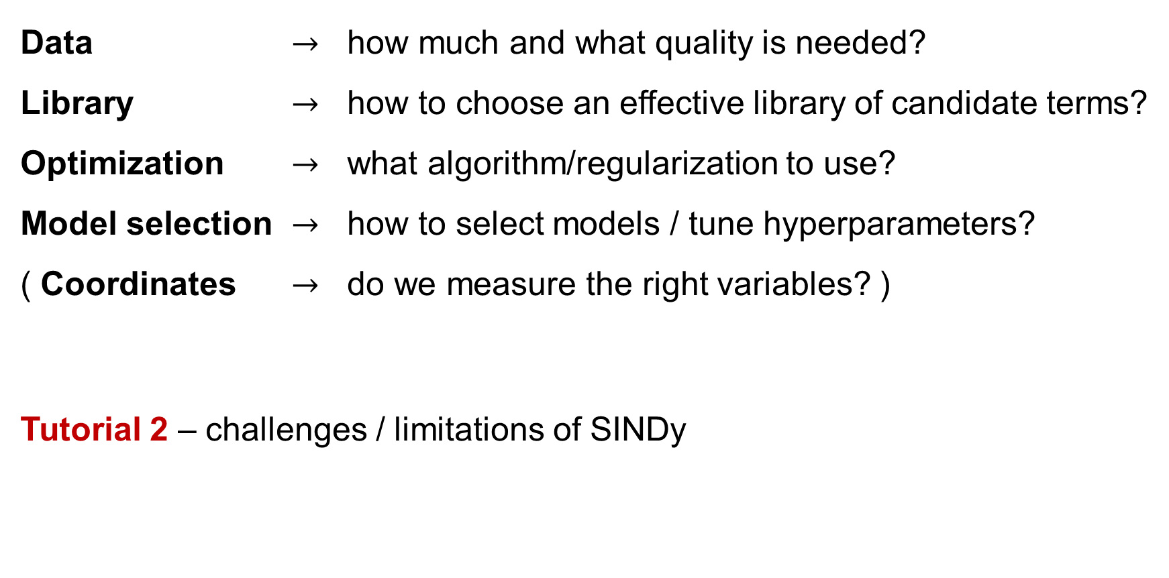
Challenges / limitations “vanilla” SINDy
Data $→$ how much and what quality is needed?
Library $→$ how to choose an effective library of candidate terms?
Optimization $→$ what algorithm/regularization to use?
Model selection $→$ how to select models / tune hyperparameters?
( Coordinates $→$ do we measure the right variables? )
Tutorial 2 – challenges / limitations of SINDy
Notes:
Noise, cut data
Order of polynomial, Pendulum
LASSO vs STLS
Change lambda, cross validation, AIC, stability selection
Show matlab tutorial
Apply PDE-find to Burgers data set -> test the limitations of the method

Slide 27
Workshop outline
Part 1: SINDy – Sparse Identification of Nonlinear Dynamics
Intro: identifying ODEs
Python example: Lorenz system
SINDy challenges and limitations
Part 2: Library (ODEs, PDEs, rational functions
Part 3: Model selection
Part 4: Noise robustness: weak form & ensemble SINDy
Part 5: PySINDy
“Vanilla” SINDy
SINDy extensions & applications
Notes:
Morning lectures, afternoon tutorials: MATLAB, PySINDy
Discuss limitations, comparison with other methods introduced: NN, Bayesian inference

Slide 28
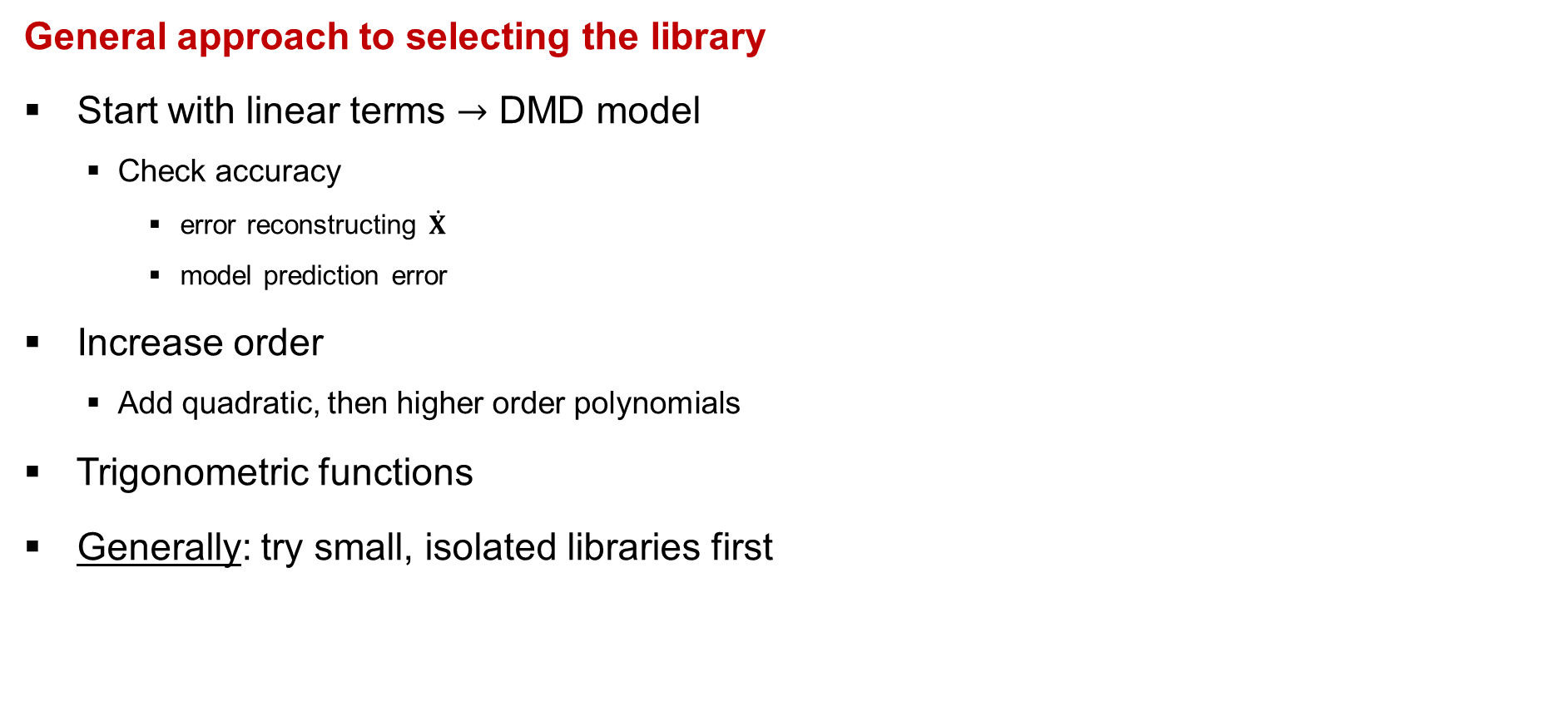
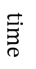
Library – general approach
General approach to selecting the library
Start with linear terms $→$ DMD model
Check accuracy
error reconstructing $\dot{X}$
model prediction error
Increase order
Add quadratic, then higher order polynomials
Trigonometric functions
Generally: try small, isolated libraries first
$$time$$
Notes:
In general: start with DMD, check accuracy (xDot and prediction), add quadratic, higher order polynomial,
Then: trigonometric functions, sines cosines …
Try different isolated libraries first -> condition number …

Slide 29
PDEs
SH Rudy, SL Brunton, JL Proctor, JN Kutz (2017) Data-driven discovery of partial differential equations.
Notes:
PDEs: paper Sam Rudy 2017
And another very important extension of the initial SINDy algorithm was introduced by Sam Rudy in 2017 …
where he extends SINDy to identify partial differential equations.
So for identifying PDEs, if we have spatio temporal data, …
for example unsteady fluid flow data measurements or also other spatio temporal data
we can use SINDy to find and build a PDE that best represents our data.
So shown here on this slide, if we for example measure the vorticity field omega and the x and y velocity fields u and v
in space and time of this flow around a cylinder, we can identify a PDE model for this using SINDy.

Slide 30
PDEs
SH Rudy, SL Brunton, JL Proctor, JN Kutz (2017) Data-driven discovery of partial differential equations.
Notes:
LHS, RHS also add partial/spatial derivatives
So just like in SINDy, we build a regression problem …
where we try to represent the time derivative of some quantity, in this case the time derivative of the vorticity, …
as a sparse combination of a library of candidate partial derivatives and nonlinear products of partial derivatives.
So we compute all of these gray columns by computing partial derivatives and nonlinear cross terms from this data,
and we try to find the sparsest combination of these terms that add up to equal the time derivative of omega, of our vorticity.

Slide 31
PDEs
SH Rudy, SL Brunton, JL Proctor, JN Kutz (2017) Data-driven discovery of partial differential equations.
Notes:
Identify NS
So when we apply this sparse regression we can actually learn, purely from data, …
that the navier stokes equations are the dynamics that are most consistent with the data and as sparse as possible.
And in Sam Rudy’s paper, he applies this extension of SINDy to a wide range of other systems and successfully identifies governing spatio-temporal dynamics.

Slide 32
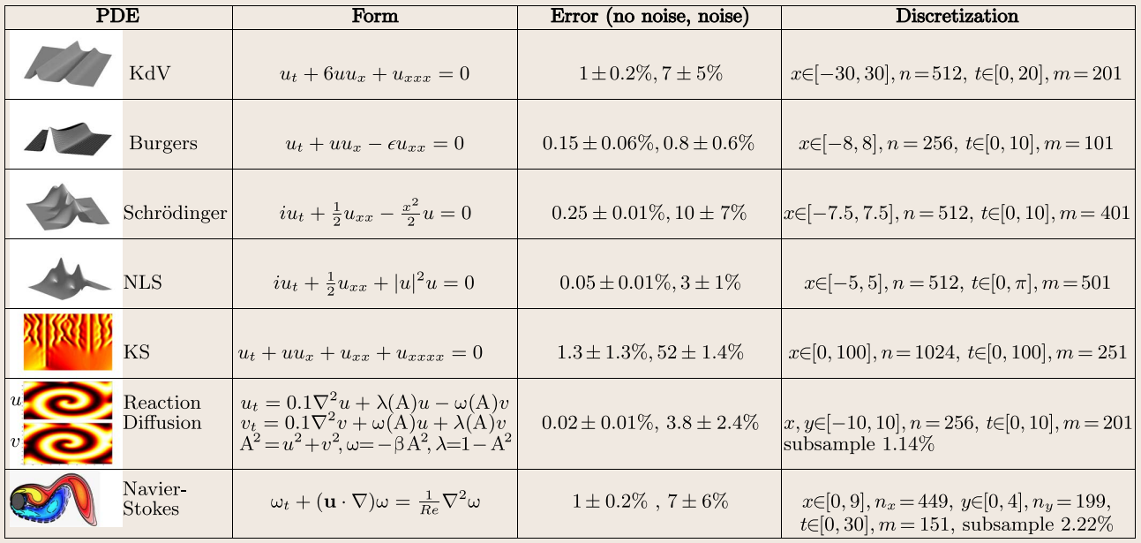
PDEs
SH Rudy, SL Brunton, JL Proctor, JN Kutz (2017) Data-driven discovery of partial differential equations.
Notes:
Identify NS
So when we apply this sparse regression we can actually learn, purely from data, …
that the navier stokes equations are the dynamics that are most consistent with the data and as sparse as possible.
And in Sam Rudy’s paper, he applies this extension of SINDy to a wide range of other systems and successfully identifies governing spatio-temporal dynamics.

Slide 33
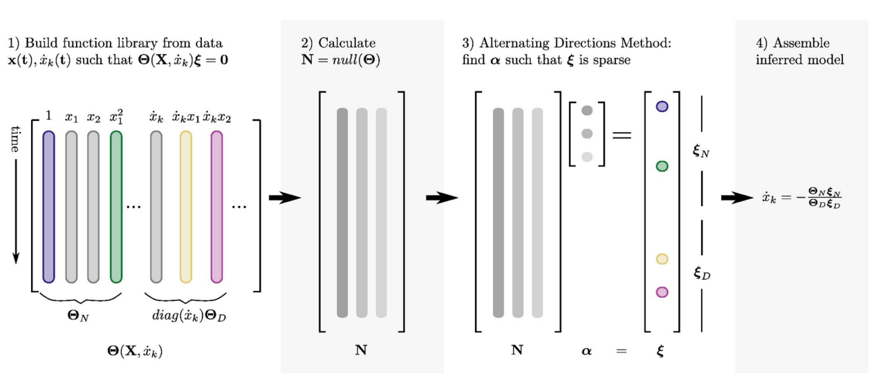
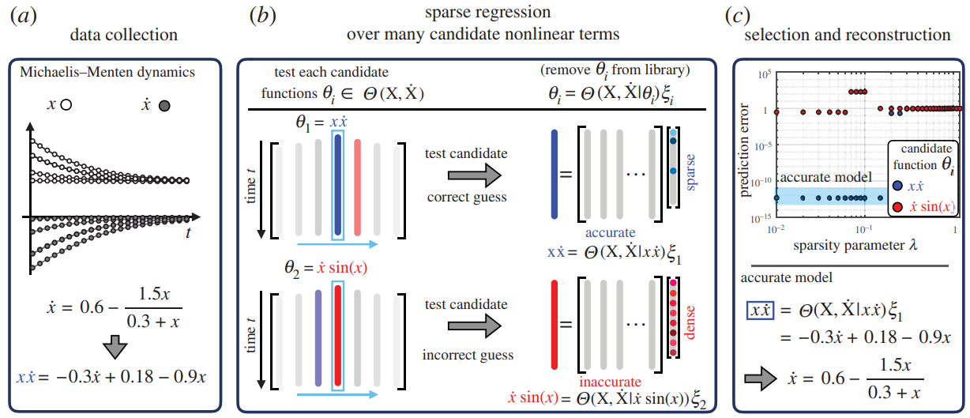
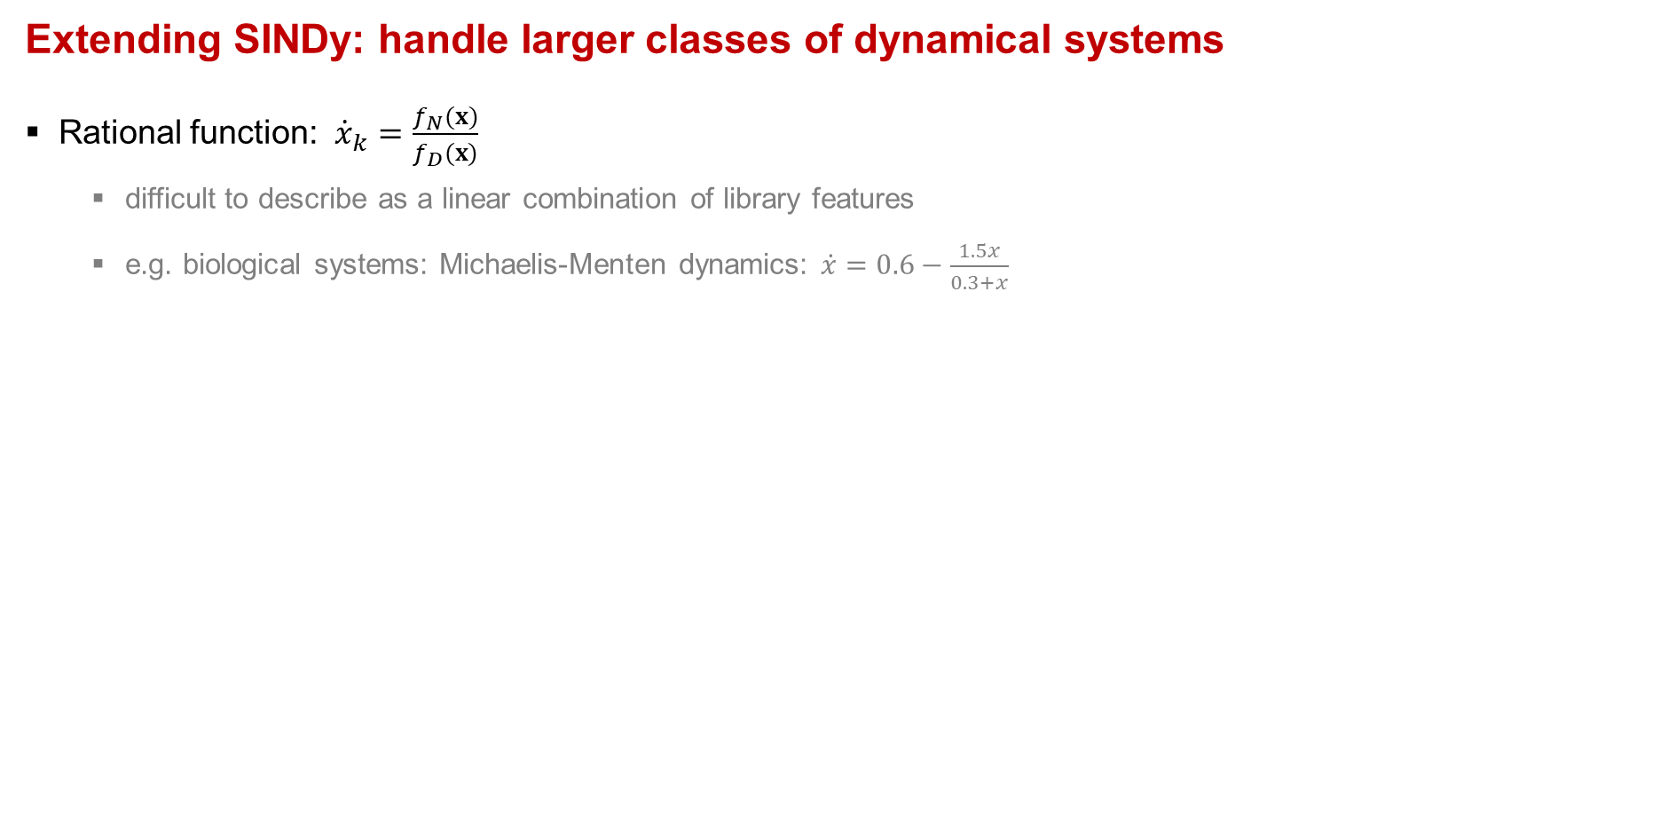
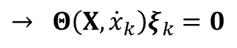
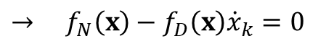
Library – rational functions
Extending SINDy: handle larger classes of dynamical systems
Rational function: ${\dot{x}}_{k}=\frac{f_{N}(x)}{f_{D}(x)}$
difficult to describe as a linear combination of library features
e.g. biological systems: Michaelis-Menten dynamics: $\dot{x}=0.6−\frac{1.5x}{0.3+x}$
$→$ $f_{N}\left(x\right)−f_{D}\left(x\right){\dot{x}}_{k}=0$
$→$ $Θ\left(X,{\dot{x}}_{k}\right)ξ_{k}=0$
SINDy-PI algorithm
Test multiple possible left-hand sides (in parallel):
Move candidate terms to LHS
Calc model prediction error
Select best model:
Sparsity & accuracy
NM Mangan, SL Brunton, JL Proctor, JN Kutz (2016) Inferring Biological Networks by Sparse Identification of Nonlinear Dynamics
K Kaheman, JN Kutz, SL Brunton (2020) SINDy-PI: a robust algorithm for parallel implicit sparse identification of nonlinear dynamics
Notes:
kinetics enzymatic reaction

Slide 34
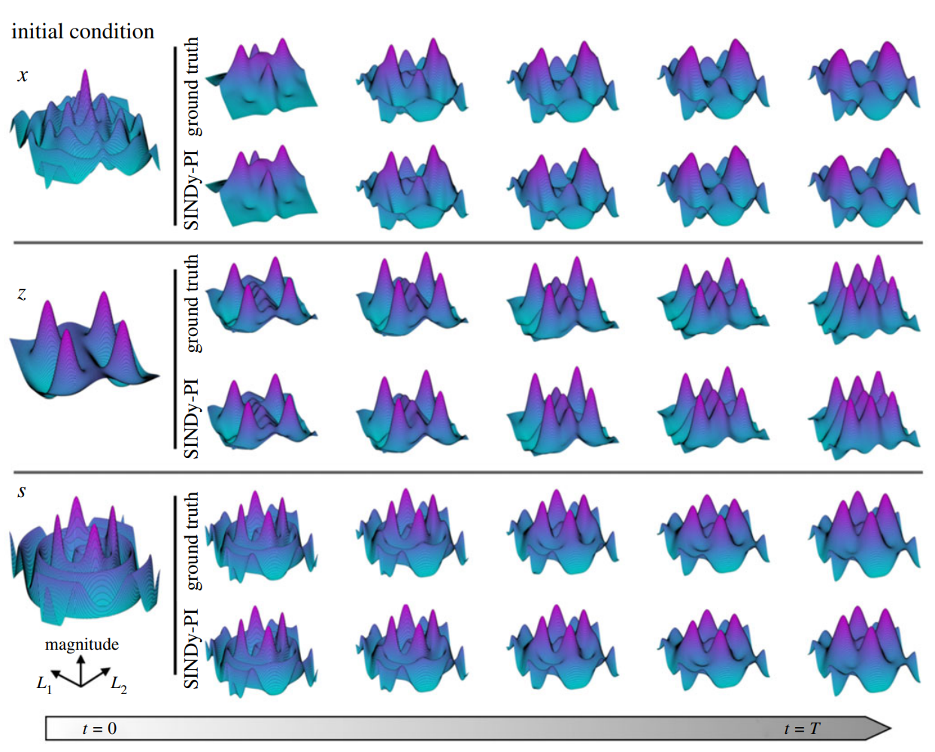
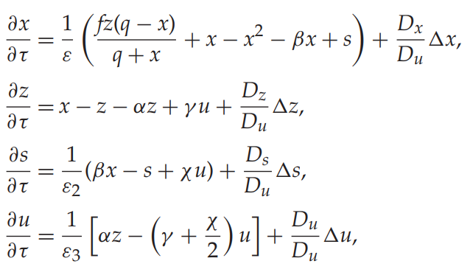
Library – rational functions
Belousov–Zhabotinsky reaction
4 coupled PDE with rational nonlinearities
SINDy-PI accurately identifies correct PDE
Not possible with standard SINDy
MATLAB: https://github.com/dynamicslab/SINDy-PI
PySINDy: interactive notebook
K Kaheman, JN Kutz, SL Brunton (2020) SINDy-PI: a robust algorithm for parallel implicit sparse identification of nonlinear dynamics
Notes:
kinetics enzymatic reaction

Slide 35
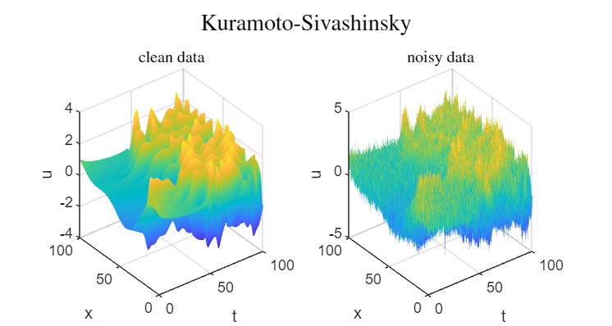
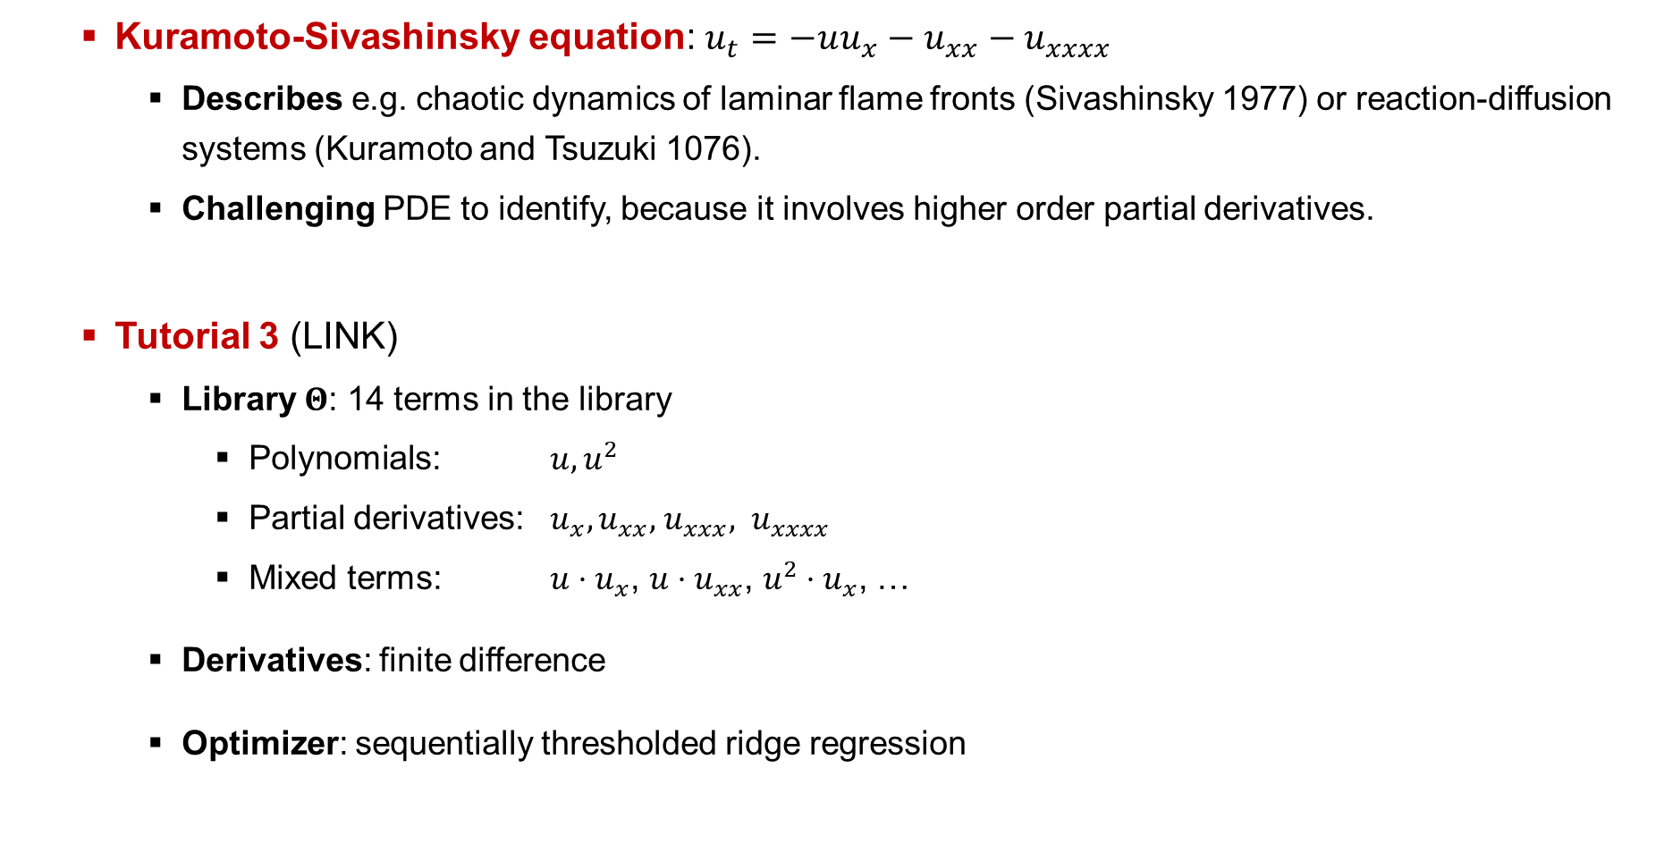
PDE tutorial – Kuramoto-Sivashinsky equation
Kuramoto-Sivashinsky equation: $u_{t}=−uu_{x}−u_{xx}−u_{xxxx}$
Describes e.g. chaotic dynamics of laminar flame fronts (Sivashinsky 1977) or reaction-diffusion systems (Kuramoto and Tsuzuki 1076).
Challenging PDE to identify, because it involves higher order partial derivatives.
Tutorial 3 (LINK)
Library $Θ$: 14 terms in the library
Polynomials: $u, u^{2}$
Partial derivatives: $u_{x},u_{xx}\text{,}{ u}_{xxx}, u_{xxxx}$
Mixed terms: $u⋅u_{x}$, $u⋅u_{xx}$, $u^{2}⋅u_{x}$, …
Derivatives: finite difference
Optimizer: sequentially thresholded ridge regression
Notes:
Show matlab tutorial
Python: PDE-FIND notebook or feature overview
Let students work on the tutorial for 15-30min

Slide 36
Workshop outline
Part 1: SINDy – Sparse Identification of Nonlinear Dynamics
Intro: identifying ODEs
Python example: Lorenz system
SINDy challenges and limitations
Part 2: Library (ODEs, PDEs, rational functions
Part 3: Model selection
Part 4: Noise robustness: weak form & ensemble SINDy
Part 5: PySINDy
“Vanilla” SINDy
SINDy extensions & applications
Notes:
Morning lectures, afternoon tutorials: MATLAB, PySINDy
Discuss limitations, comparison with other methods introduced: NN, Bayesian inference

Slide 37
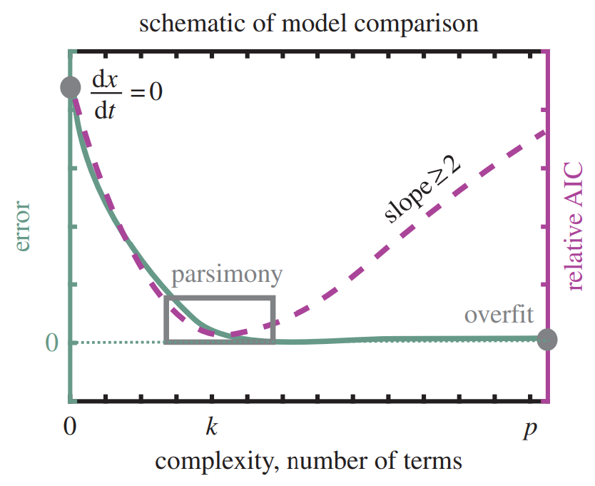
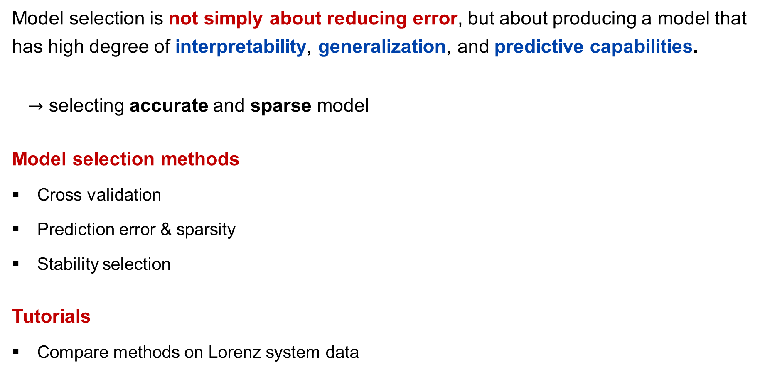
Model selection
Model selection is not simply about reducing error, but about producing a model that has high degree of interpretability, generalization, and predictive capabilities.
$→$ selecting accurate and sparse model
Model selection methods
Cross validation
Prediction error & sparsity
Stability selection
Tutorials
Compare methods on Lorenz system data

Slide 38
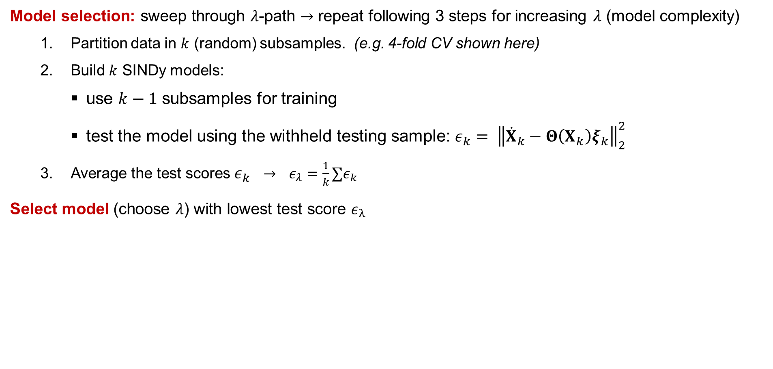
Model selection – k-fold cross-validation
Model selection: sweep through $λ$-path $→$ repeat following 3 steps for increasing $λ$ (model complexity)
Partition data in $k$ (random) subsamples. (e.g. 4-fold CV shown here)
Build $k$ SINDy models:
use $k−1$ subsamples for training
test the model using the withheld testing sample: ${ε_{k}= \left\|{\dot{X}}_{k}−Θ\left(X_{k}\right)ξ_{k}\right\|}_{2}^{2}$
Average the test scores $ε_{k}$ $→$ $ε_{λ}=\frac{1}{k}∑ε_{k}$
Select model (choose $λ$) with lowest test score $ε_{λ}$
Testing
Training
Training
Training
Training
Testing
Training
Training
Training
Training
Testing
Training
Training
Training
Training
Testing
Notes:
Mention LASSO path

Slide 39

Model selection – Prediction error & sparsity
Sum of model prediction error plus number of active terms
SINDy model prediction error $→$ $E_{avg}=\sum_{τ}{|y_{i}−g\left(x_{i};μ\right)|}$
$y_{i}$ observed outcomes (time series data)
$g(x_{i};μ)$ SINDy model prediction (numerically integrated SINDy ODE)
Model score: $AIC =m\ln\left({\frac{1}{m}\left(\sum_{i=1}^{m}{E_{avg}}\right)}^{2}\right)+2k$
$m$ number of test time series (e.g. starting from different initial conditions)
$k$ number of non-zero terms
model quality (prediction error) model complexity (number of terms)
We can compute AIC score for a range of $λ$ $→$ sweep through $λ$-path
Elbow (minimum) in AIC curve: allows for intuitive model selection
Idea introduced first in SINDy Akaike Information Criteria paper: NM Mangan, JN Kutz, SL Brunton, JL Proctor (2017) Model selection for dynamical systems via sparse regression and information criteria
Notes:
statistical framework for selecting a model from a set of candidate models given validation data
Error of overfit models small -> therefore add number of terms
L(x,mu) = L(mu|x) -> likelihood of model given the data
Change of sign: conditional probability between 0 and 1: log 0 to 1 -> –infty to 0

Slide 40


Model selection – stability selection
Calculate the stability (importance) of each coefficient over the regularization path $λ$
Generate $B$ random subsamples (size $N/2$) of the library and derivative data without replacement
Compute $B$ SINDy models over regularization path $λ$
Calculate the $λ$-dependent stability (or importance) $Π_{k}^{λ}$
Stability: probability of a coefficient to be non-zero
Find stable support: $Π_{k}^{λ}>π_{th}=0.8$
e.g. coefficient is non-zero in 80% of the models
S Maddu, BL Cheeseman, IF Sbalzarini, CL Muller (2019) Stability selection enables robust learning of partial differential equations from limited noisy data.
Notes:
From left to right, decrease lambda (from trivial solution to OLS)
Inclusion probability increases from left to right

Slide 41




Model selection – summary
Model selection is not simply about reducing error, but about producing a model that has high degree of interpretability, generalization, and predictive capabilities.
$→$ selecting accurate and sparse model
Cross validation
Prediction error & sparsity
Stability selection
Notes:
CV: does not consider complexity of model -> might overfit
AIC considers complexity of model -> need to solve the ODE
Stability selection useful for PDEs

Slide 42
Tutorials model selection
Workshop tutorial
LINK
PySINDy
AIC is implemented in example 16
MATLAB live scripts
LINK

Slide 43
Workshop outline
Part 1: SINDy – Sparse Identification of Nonlinear Dynamics
Intro: identifying ODEs
Python example: Lorenz system
SINDy challenges and limitations
Part 2: Library (ODEs, PDEs, rational functions
Part 3: Model selection
Part 4: Noise robustness: weak form & ensemble SINDy
Part 5: PySINDy
“Vanilla” SINDy
SINDy extensions & applications
Notes:
Morning lectures, afternoon tutorials: MATLAB, PySINDy
Discuss limitations, comparison with other methods introduced: NN, Bayesian inference

Slide 44
Noise robustness: weak form & ensemble SINDy
Literature
Ensemble SINDy:
U Fasel, JN Kutz, BW Brunton, SL Brunton (2022) Ensemble-SINDy: Robust sparse model discovery in the low-data, high-noise limit, with active learning and control.
SM Hirsh, DA Barajas-Solano, JN Kutz (2022) Sparsifying priors for Bayesian uncertainty quantification in model discovery.
LM Gao, U Fasel, SL Brunton, JN Kutz (2023) Convergence of uncertainty estimates in Ensemble and Bayesian sparse model discovery.
U Fasel (2025) Sparse Identification of Nonlinear Dynamics with Conformal Prediction.
Bayesian SINDy:
SM Hirsh, DA Barajas-Solano, JN Kutz (2022) Sparsifying priors for Bayesian uncertainty quantification in model discovery.
L Fung, U Fasel, M Juniper (2025) Rapid Bayesian identification of sparse nonlinear dynamics from scarce and noisy data.
Integral and weak form SINDy:
H Schaeffer, SG McCalla (2017) Sparse model selection via integral terms.
PAK Reinbold, DR Gurevich, RO Grigoriev (2020) Using noisy or incomplete data to discover models of spatiotemporal dynamics.
D Messenger, DM Bortz (2021) Weak SINDy for partial differential equations.
AA Kaptanoglu, …, ZG Nicolaou, … (2022) PySINDy, SINDyCP

Slide 45
Ensemble SINDy
Notes:
Weak form: higher order derivatives, PDEs, …

Slide 46
Ensemble SINDy
Combining predictions from multiple models
→ Improve accuracy of model prediction
→ Reduce variance and help avoid overfitting
Popular ensemble learning method
→ Bootstrap aggregating or bagging
Connections to model selection
→ Cross-validation and stability selection use ensemble of models to select best model

Slide 47

Ensemble SINDy

Slide 48
Ensemble SINDy
SINDy Bootstrap:
randomly sample m new rows with replacement from the original m rows of the data matrices.
generate n bootstraps and identify n SINDy models in the ensemble
1
m samples in time
2
n

Slide 49
Ensemble SINDy

Slide 50

Ensemble SINDy

Slide 51

Ensemble SINDy

Slide 52

Ensemble SINDy

Slide 53


Ensemble SINDy – different sampling strategies
$(a)$ Success rate: identifying correct model structure
$(b)$ model coefficient error
Bragging (robust bagging) SINDy generally performs best
Robust bagging: aggregate by taking median of identified models

Slide 54

Ensemble SINDy – active learning
Collecting data may be time consuming and expensive
Efficient exploration: maximally inform model discovery
E-SINDy active learning:
Exploit ensemble statistics to find and explore high uncertainty regions in the feature space
Iteratively identify E-SINDy models to improve data efficiency of model discovery
9

Slide 55
Ensemble SINDy – active learning
9

Slide 56

Ensemble SINDy – probabilistic models
Robust model discovery: high noise, low data limit
E-SINDy identifies probabilistic models at low computational cost

Slide 57
Ensemble SINDy tutorials
MATLAB
E-SINDy vs SINDy: Identify Lorenz system on noisy data
GitHub RSPA paper: https://github.com/urban-fasel/EnsembleSINDy
ODE and PDE examples
Active learning
MPC
PySINDy
https://github.com/dynamicslab/pysindy/blob/master/examples/13_ensembling.ipynb
ODE and PDE examples

Slide 58

UQ-SINDy – sparse Bayesian inference
Estimating model coefficient distributions
→ model coefficient uncertainty, due to observation errors, limited data
→ model coefficient inclusion probability: how likely a coefficient is active
Bayes rule: $p\left(Ξ | X\right)∝p\left(X | Ξ \right)p\left(Ξ\right)p(x_{0})$
$p\left(Ξ | X\right)$ posterior distribution of the model coefficients $Ξ$ conditioned on the data $X$
$p\left(X | Ξ\right)$ likelihood of the model with coefficient $Ξ given the data$
$p\left(Ξ\right)$ prior distribution of the model coefficients
We want to learn the posterior distribution of the model coefficients $Ξ$
Computing posterior distribution not analytically tractable
Sampling-based methods such as Markov chain Monte Carlo (MCMC)
Paper: SM Hirsh, DA Barajas-Solano, JN Kutz (2022) Sparsifying priors for Bayesian uncertainty quantification in model discovery.
Notes:
the Laplace prior shares the same maximum likelihood estimator as the Lasso (Bayesian vs Frequentist setting)

Slide 59



UQ-SINDy – method
Collect data
Construct library
Symbolic library $→$ used as generative model
Construct model likelihood
Lognormal likelihood: $p\left(X | Ξ\right)=\prod{\prod{\frac{1}{σ_{j}\sqrt{2π}}exp\left[\frac{−1}{2σ_{j}^{2}}{\left|log y_{i,j}−log {\hat{x}}_{j}\left(t_{j},Ξ\right)\right|}^{2}\right]}}$
SINDy prediction at time $t$ for model $Ξ$: $\hat{x}\left(t,Ξ\right)=x_{0}+\int_{t_{0}}^{t}{Θ\left(x\left(t^{′}\right)\right)Ξdt′}$
Construct model priors
Sparsity promoting priors: 1) spike and slab, 2) regularized horseshoe
e.g. Hierarchical spike and slab prior: $ξ_{j}|λ_{j}\sim 𝒩\left(0,c^{2}\right)λ_{i}$, $λ_{j}\sim Ber(π)$
If $λ=1:$ $ξ_{j}$ follows slab distribution ($𝒩\left(0,c^{2}\right)$)
if $λ=0$: $ξ_{j}$ follows spike distribution (Dirac delta distribution centered at zero)
Bayesian inference
Employ MCMC to draw samples from the posterior distribution
Sample SINDy models and integrate over $t$ to compute $\hat{x}\left(t,Ξ\right)$
Challenge: integrating potentially unstable models
Paper: SM Hirsh, DA Barajas-Solano, JN Kutz (2022) Sparsifying priors for Bayesian uncertainty quantification in model discovery.
Notes:
the Laplace prior shares the same maximum likelihood estimator as the Lasso (Bayesian vs Frequentist setting)
SS prior: xi follows normal distribution times lambda, which in turn follows Bernoulli distribution, taking value 1 or 0
MCMC
rh-SINDy: No-U-Turn Sampler (NUTS)
ss-SINDy compound step sampler implemented in PyMC3

Slide 60

UQ-SINDy – sparse Bayesian inference
Python code GitHub paper Seth Hirsh Python
→ https://github.com/sethhirsh/BayesianSindy/blob/master/figures/figure3.ipynb
Alternative UQ-SINDy papers
→ S Zhang, G Lin (2018) Robust data-driven discovery of governing physical laws with error bars.
→ Y Yang, MA Bhouri, P Perdikaris (2020) Bayesian differential programming for robust systems identification under uncertainty.
Paper with code, introducing sparsity promoting priors
→ D Korobilis, K Shimizu (2021) Bayesian Approaches to Shrinkage and Sparse Estimation.
→ GitHub https://github.com/korobilis/hierarchicalbayes $→$ Code\Linear Regression\SkinnyGibbs
Tutorial Bayesian Inference to fit parameters of dynamical system
→ S Jbabdi https://users.fmrib.ox.ac.uk/~saad/ONBI/bayes_practical.html
Notes:
the Laplace prior shares the same maximum likelihood estimator as the Lasso (Bayesian vs Frequentist setting)

Slide 61


Some E-SINDy follow up papers …
E-SINDy connection to UQ and Bayesian SINDy…
→ is asymptotically equivalent to Bayesian-SINDy
→ has lower computational cost $→$ $≈$3000 times less expensive
→ can perform valid uncertainty quantification with statistical guarantee
(a) Uncertainty quantification guarantees
(b) Exponential convergence theorem
Paper: LM Gao, U Fasel, SL Brunton, JN Kutz (2023) Convergence of uncertainty estimates in Ensemble and Bayesian sparse model discovery.

Slide 62


Some E-SINDy follow up papers ...
E-SINDy with conformal prediction
→ uncertainty quantification in time series prediction with coverage guarantees
→ model selection using library feature (covariate) importance measure
→ quantifying uncertainty in the identified model coefficients
(a) Method overview
(b) Coverage and width over target coverage
Paper: U Fasel (2025) Sparse Identification of Nonlinear Dynamics with Conformal Prediction.

Slide 63
Weak SINDy
Notes:
Weak form: higher order derivatives, PDEs, …

Slide 64


Weak SINDy
Integral formulation: H Schaeffer, SG McCalla (2017) Sparse model selection via integral terms.
Reformulate ${\dot{x}}_{i}=Θ\left(x\right)ξ_{i}=\sum{f_{j}\left(x\right)ξ_{i,j}}$ to integral form
$→$ $x_{i}\left(t\right)=x_{i}\left(0\right)+\sum{d_{j}\left(x,t\right)ξ_{i,j}}$
$d_{j}\left(x,t\right)=\int_{0}^{t}{f_{j}\left(x\left(τ\right)\right)dτ}$ integrated library function
$f_{j}(x)$ library function
$ξ_{i,j}$ model coefficient
Solve $ℓ_{0}$-penalized least squares $→$same as standard SINDy
Weak form SINDy: generalizes integral form SINDy
Integration against test function
Moving derivatives off of the data onto test functions via integration by parts
Different implementations
PAK Reinbold, DR Gurevich, RO Grigoriev (2020) Using noisy or incomplete data to discover models of spatiotemporal dynamics.
D Messenger, DM Bortz (2021) Weak SINDy for partial differential equations.
AA Kaptanoglu, …, ZG Nicolaou, … (2022) PySINDy, SINDyCP
Notes:
Weak form: higher order derivatives, PDEs, …

Slide 65

Weak SINDy
Idea: Move derivatives off of the data onto a test functions via integration by parts
PDE: $u_{t}=Θ\left(u\right)ξ=Θ\left(u,u_{x},u_{xx},…,x\right)ξ$
$u(x,t)$: state, $Θ$: library, $ξ$: coefficients $x:$ space, $t$: time
Test function: $φ(x,t)$ smooth & compactly supported: $φ(x,t)$ vanishes along domain bound
e.g. $φ\left(x,t\right)={\left(x^{2}−1\right)}^{p}{\left(t^{2}−1\right)}^{q}$ on domain $Ω=\{\left(x,t\right) :\left|x\right|≤1, |t|≤1\}$
Integration by parts: remember product rule ${\left(f\left(x\right)g\left(x\right)\right)}^{′}=f^{′}\left(x\right)g\left(x\right)+f\left(x\right)g′(x)$
$\int_{a}^{b}{f\left(x\right)g′\left(x\right)dx}=\int_{a}^{b}{\left(f\left(x\right)g\left(x\right)\right)′dx}−\int_{a}^{b}{f′\left(x\right)g\left(x\right)dx}=f\left(b\right)g\left(b\right)−f\left(a\right)g\left(a\right)−\int_{a}^{b}{f′\left(x\right)g\left(x\right)dx}$
Weak form: Multiply each term in PDE with test function and integrate over $k$ different domains $Ω_{k}$
Domain $Ω_{k}$, e.g. 2D space $x$ and time $t$, $dΩ=dx dt$, $∂Ω_{k}$: domain bounds
LHS: $\int_{Ω_{k}}{φu_{t}}dΩ={\left[φ\left(x,t\right)u\left(x,t\right)\right]}_{{∂Ω}_{k}}−\int_{Ω_{k}}{φ_{t}u}du=−\int_{Ω_{k}}{φ_{t}u}du$
RHS: term by term integration by parts: move derivatives $u_{x},u_{xx},…$ from data onto test function
0
Notes:
Integrating both sides of product rule
Depending on library -> show on example of KS equation

Slide 66



Weak form parameter estimation (SINDy on next slide)
Kuramoto-Sivashinsky equation: $u_{t}=−uu_{x}−u_{xx}−u_{xxxx}$
Integration by parts: multiply each term with test function and move derivative onto test function
Term $u_{t}$: $q_{0}^{k}=\int_{Ω_{k}}{φu_{t}}dΩ=−\int_{Ω_{k}}{φ_{t}u}dΩ$
Term ${uu}_{x}$: $q_{1}^{k}=\int_{Ω_{k}}{φ{u u}_{x}}dΩ=−\int_{Ω_{k}}{(φ_{x}u+φu_{x}}) u dΩ=−\int_{Ω_{k}}{φ_{x}u^{2}}dΩ−\int_{Ω_{k}}{φ{u u}_{x}}dΩ → \int_{Ω_{k}}{φ{uu}_{x}}dΩ=−\frac{1}{2}\int_{Ω_{k}}{φ_{x}u^{2}}dΩ$
Term $u_{xx}$: $q_{2}^{k}=\int_{Ω_{k}}{φu_{xx}}dΩ=−\int_{Ω_{k}}{φ_{x}u_{x}}dΩ=\int_{Ω_{k}}{φ_{xx}u}dΩ$
Term $u_{xxxx}$: $q_{3}^{k}=\int_{Ω_{k}}{φu_{xxxx}}dΩ=\int_{Ω_{k}}{φ_{xxxx}u}dΩ$
Test function: $φ={\left({\underline{x}}^{2}−1\right)}^{p}{\left({\underline{t}}^{2}−1\right)}^{q}$
$p=4$, $q=3, \underline{t}=(t−t_{k})/H_{t}$, $\underline{x}=(x−x_{k})/H_{x}$
Integrate over domain: $Ω_{k}=\left\{\left(x,t\right) :\left|x−x_{k}\right|≤H_{x},\left|t−t_{k}\right|≤H_{t}\right\}$
Integrate all $q_{i}^{k}$ over $N$ different domains $Ω_{k}$ of size $H_{x}$ and $H_{t}$
New system: $q_{0}=\sum_{n=1}^{3}{q_{n}ξ_{n}}=Qξ$ $q_{0}∈ℝ^{k}$, $Q∈ℝ^{k×3}$, $ξ∈ℝ^{3}$
$→$ $\hat{ξ}=argmin_{ξ} {\left\|q_{0}−Qξ\right\|}_{2}^{2} + λ{\left\|ξ\right\|}_{0}$
Notes:
Advection, Laplacian, biharmonic term
describes the chaotic dynamics of laminar flame fronts [13], reaction-diffusion systems [14], and coating flows [15]. This is a notable example of a nonlinear PDE that involves highorder partial derivatives, which has made it difficult to accurately reconstruct from noisy data

Slide 67

Weak form parameter estimation (SINDy on next slide)
MATLAB example
Kuramoto-Sivashinsky equation: $u_{t}=−uu_{x}−u_{xx}−u_{xxxx}$
Only estimate parameters without selecting models $→$ ${\hat{ξ}}_{k}=argmin_{ξ_{k}} {\left\|{\dot{X}}_{k}−Θ\left(X\right)ξ_{k}\right\|}_{2}^{2}$
Notes:
nchoosek binomial coeff
Students solve the weak sindy tutorials

Slide 68

Weak SINDy
MATLAB example
Kuramoto-Sivashinsky equation: $u_{t}=−uu_{x}−u_{xx}−u_{xxxx}$
Library:
Advection $u u_{x}$
Laplacian $u_{xx}$
Biharmonic $u_{xxxx}$
Linear $u$
1st order derivative $u_{x}$
3rd order derivative $u_{xxx}$
Quadratic $uu$
Cubic $uuu$
Test function: $φ(x,t)={\left(x^{2}−1\right)}^{p}{\left(t^{2}−1\right)}^{q}$
Derivative: $\frac{∂}{∂x^{d}}{\left(x^{2}−1\right)}^{p}{\left(t^{2}−1\right)}^{q}=\sum_{k=0}^{p}{\left({p \atop k}\right){\left(−1\right)}^{k}}\frac{\left(2\left(p−k\right)\right)!}{\left(2\left(p−k\right)−d\right)!}x^{2\left(p−k\right)−d}{\left(t^{2}−1\right)}^{q}$
Compare SINDy vs weak-SINDy
Clean and noisy data
Notes:
nchoosek binomial coeff
Students solve the weak sindy tutorials

Slide 69
Part 4 summary
Ensemble SINDy
Ensembling for noise robust model identification
Active learning
UQ-SINDy
Weak-SINDy
Integral and weak form SINDy methods
Weak form parameter estimation
Weak SINDy KS example

Slide 70

Coding examples
MATLAB
Implement different ensemble SINDy methods and test it on the KS data
Compare noise robustness, data sampling rate and length
Test the weak form SINDy method on different PDEs $→$ Burger’s
PySINDy
E-SINDy: https://github.com/dynamicslab/pysindy/blob/master/examples/13_ensembling.ipynb
Weak SINDy: https://github.com/dynamicslab/pysindy/blob/master/examples/12_weakform_SINDy_examples.ipynb

Slide 72

Python tutorial – identify ODE
PySINDy
SINDy python package: JOSS article
GitHub: https://github.com/dynamicslab/pysindy
Check out the binder notebook examples!
PySINDy lectures: notebooks and YouTube videos
GitHub interactive notebook
Tutorial videos Alan Kaptanoglu
Lorenz system ODE tutorial
Start with the feature overview tutorial in PySINDy to identify the Lorenz system
Try to identify the Rossler attractor: from pysindy.utils import rossler
Generate data: x_train = solve_ivp(rossler, ...
Test other data sets generated from different ODEs $→$ ODEs in PySINDy
Large library of chaotic systems: https://github.com/williamgilpin/dysts
Notes:
Show tutorial in binder
Change system to rossler
Let the students work in matlab or python for 15-30min

